Slide 1

Deductions Best in Class Process & Policies

Slide 3

Agenda
1
Genpact Expertise in Deductions Management
2
Deductions Drivers
3
KH Deductions Analytics
4
Preventable Opportunities
5
Recoverable Opportunities
6
Critical Success Factors - Governance, Over all Plan & Timelines
7
Pricing Analytics
8
Plan of action

Slide 4
























Our expertise in deductions and dispute management…
Expertise
Trade Promo Optimization
Pricing Optimization
Expertise
New Item Form
Contract / Event Creation
Pricing Form
Compliance
Coding
Recoveries
Unsold Inventory
Order Fulfilment
Compliance
Target Operating Model
Best in Class Process & Policies
Integrated Operations & Governance
Customer Playbook
Industry Insights
Digital Driven Insights
Sales Assist
Order Assist
Contract Assist
Experience
LSH
CGR
HMS
Partnerships
Easy to deploy tech stack
E2E Promo Planning to Event creation to Contract Compliance
Signal & Alert Mechanism
40+ Algorithms
Modular Approach

Slide 5
Revenue Leakage across Value Chain
L1 & L2
Processes
Plan
Execute
Deliver
Collect
Customer
Business Plan
Contract/
Event Creation
Sale Order
Demand Planning
Capacity Planning
Supply Network Planning
Material Planning
Purchase & Payment
Logistics Planning
Order Management
Reverse Logistics
Billing/ Invoicing
Credit & Collections
Cash Application
Deductions Management
CBP
C/ EC
SO
DP
CP
SNP
MP
P&P
LP
OM
RL
B/I
C&C
CA
DM
L3 Performance Metrics
Yearly Budget Assignment
Contract Accuracy
Manual Orders
Forecast Accuracy
Inadequate Capacity
Case Fill Rate
Capital Turnover Ratio
Utilization
Price Error
Customer/ Carrier Claims
Invoice Accuracy
Unearned Cash Discount
Tolerance W/O
Invalid SC Deductions
Demand Variation - EWI
Actual Demand as % to Forecast
Compliance to Plan
OTIF
PGI %
Overage Billing
Promo Input to Demand Forecast
Cost of Order Entry
Forward Planning
Ret. Auth.
Bad Debt W/O
Cash on A/c
Category Plan
Gap to SS
VMI-DOS/ Turns
Aged Claim W/O
Incremental to Contract Allowances
Trade Invalid
NPD Forecast
SC Liquidation
Off Invoice Deals
Price deductions
Missing Promo Adjustments
Over Capacity
POS - 3 Way Match Accuracy
Obsolescence Risk
Spoilage
Bracket Exceptions
Inventory Spend
Supply Chain Allowances
Master-data Accuracy
Digital/ AI/ RPA
SFG Plan
Mat Updates
FLP - DRP
Pricing Fix
CFR – Predictive Analytics
Redep. Tool
I-doc Error Res.
Vendor Scorecard
DRP
Product Cuts
BU Tracker
CI/Proforma
ExCIT
RPA
AI Application
Other Automation

Slide 6
Genpact Cognitive Analytics to segregate Entitled, Preventable and Unauthorized Deductions
Entitled
Preventable
Unauthorized
Authorized disputes and deductions that are the result of the agreed conditions; considered as the “cost of doing business”
Volume based rebates
Temporary discounts
Permanent discounts
Promotions
Advertising
Logistic discounts
Price protection
Allowances (e.g damages, expiry)
Valid cases that are the result of poor operational practices, communication challenges and terms misinterpretation
Misinterpreted prices and discount
Processing errors or delays
Delivery delays
Damages
Shortages
Wrong/miss – shipments
Products substitutions
EDI communication error
Invalid cases that are the result of compliance related issues and poor adherence to the agreed policies and terms
Unearned cash discounts
Excessive volume rebates or discounts
Inapplicable vendor compliance penalties
Refused shipments
Customer processing errors
Duplicate disputes and deductions
CPU loads – SC inefficiencies

Slide 7
Key drivers for leakages
Reasons
Pricing/ OI deals/
Promotions
Unsalable
(SKU & Retailer analytics)
OSD & Returns
Allowances
OTF Penalties
Incorrect price updated in MDM
Sales not Communicated price change to customers
Item Set up
EDI Failure
Bracket 1 to Bracket 3 Pricing
Case vs Unit Issue - Retailer Item set up
Retailer refused to accept price
Retailer didn’t accept prices leads to MDM issue
OSD & Pricing Double dip
Palletization
Duplicate/Over Deals offered
Product Discontinuation
Double Dip with Swell
No Swell given
Customer returning back swell
Swell is not able to cover actual loss (Due to higher product price)
Product Discontinued previous year but customer deducting in current year
Product Substitution
Case vs Pallet issues
Temp abuse/Shelf life/Load shift/Incorrect delivery/Delayed deliveries
Truck Capacity
Combined shipment
One order in multiple truck
Retailers receiving issues
OSD & Pricing Double dip
Labeling / Bagging/ prep etc.
Palletization
Freight Allowance
Rate & weight issues , Communication issues, EDI failure
Customer double dipping
Freight and Super fuel accounting
Swell Allowance
Swell Double dip
Swell given on partial Product
Swell agreed but not given
Swell was not agreed but deducted
Lumper Charges
Lumper allowance not agreed but retailers are charging
Lumper charges on Prepaid Load/Carriers as well as Customers charging fees
Retailer warehouses holding the truck
Retailers warehouses on capacity
KH WH's loaded order late
Carrier delivered late
Incorrect Appointment Scheduling
Retailers updating inventory late in system
Carrier without license - Prepaid
Over inventory loaded by WH
Customer refused delivery due to shelf life
KH WHs calculating shelf life from delivery date , instead receiving date
MDM updated with Incorrect Shelf life
Product Substitution
Case vs Pallet issues
Prevention Execution Steps
Insight & Action Hub to Identify Trends and Prioritize by Theme
Insight & Action Hub to Provide L2-L4 Insights
Governance Council to determine intervention
Governance Council to build controls
Insight & Action Hub monitor Impact
Governance Council to approve Impact
Insight & Action Hub
Execution in phases:
By Themes (starting with Pricing/OI Deals/Promotions
By Retailers
Wave 1: Top 5 Retailers
Wave 2: 6-10 Retailers
Governance Council
Notes:
SAP enhanced coding's recommended by Ops team will help HRC to expedite the exicutions

Slide 8
Policies – Across Industry
Write Off Policy | 26B Food Company | 55B CPG | 28B - Beverage | 11B – Food Company | 6B- Pharma | $18B – Chocolate & Food
Customer Payment terms - | Standard Defined by Customer | Standard | Standard | Standard | Standard | Standard
Unidentified- Auto Sweep | Yes – 90 days | Yes- 90 days | No | No | No | No
Invalid not recovered - Auto Sweep | Yes | No | No | No | No | No
Non-Resolved deductions - Auto Sweep | Yes | No | No | No | No | No
Undertoelrance Limit | $500 | $250 | $250 | $300 | $400 | $400
Invoice Sweeps | Yes | No | No | No | No | No
Cash Discount - Policy | $26B NA food company | $80B CPG | $28B NA beverage | $11B Food Company | $6B Pharma | $36B- Food Company
Cash Discount - Gross to Net | Gross | Net | Gross | Gross | Net | Gross
Cash Discount - % Terms | 1% | 1% | 2% | 1% | 2% | 2%
Cash Discount - OI or deductions | Deductions | OI | Deductions | Deductions | Deductions | Deductions
Cash Discount - Penalties Covered | No | Yes | No | No | No | No
Cash discount - Paid after due term | 27% | 5% | 40% | 27% | 41% | 40%
Notes:
SAP enhanced coding's recommended by Ops team will help HRC to expedite the exicutions

Slide 9
Policies – Across Industry
Recoveries Procedures | $26B NA food company | $80B CPG | $28B NA beverage | $11B Food Company | $6B Pharma | $36B- Food Company | 14B Beauty | 80B Healthcare Company
OSD & Pricing | No | No | No | % allowance offered to cover | Yes | No | 40:60 Sharing | No
Settlement with Promotions | No | No | No | No | No | No | No | Yes
Penalties | Limited to SV | yes | No | No | Yes | No | No | No
Cash discount | OI - No recoveries | OI- No Recoveries (Except Walgreens) | Deduction- Yes | Deduction- Yes | Deduction- Yes | Deduction- Yes | Yes | Yes
MSA Defined settlement process - Top retailers | No | No | No | No | No | Yes | Yes | Partial
Genpact Collections - Incentive | No | No | No | No | No | No | No | No
Client Sales Incentive | No | No | No | No | No | No | No | No
Trade Promotions Validations | KH | Uniliver | Coke | CAG | Alcon | ELC | Genpact Proposed
Bill payment vs Deductions | Deductions/Invoice vs Contracts & 3rd party data | Deductions/Invoice vs Contracts | Deductions/Invoice vs Contracts | Deductions/Invoice vs Contracts | Deductions/Invoice vs Contracts | Deductions/Invoice vs Contracts | Deductions/Invoice vs Contracts & 3rd party data/billing based Accruals
Experiment based - Trade promo | No | No | No | No | No | No | Leverage Genpact-Ever site Partnership
Payment vs Deductions | Both | Both | Both | Deductions only- except indirect customers | Deductions only- except indirect customers | Deductions only- except indirect customers | Both
Notes:
SAP enhanced coding's recommended by Ops team will help HRC to expedite the exicutions

Slide 10
Deductions – Best in Class Process
Deduction Key metrics | CPG* | Key Enablers
Over All Deduction | Best In Class | to drive best in class results
Coding within 7 days – Manual 24 Hrs. in Digital Environment | 95% of all deductions | Requires digital to code 80% of all deductions programmatically
Validation within 90 days | 95% of all deductions | Requires digital to validate 70% of all deductions programmatically
Invalids | 7% of total incoming deductions | Execution Analytics, MSA driven Settlements , loss Sharing model
Invalid Recovery | 60% -in Recovery Model 50% of over all Deductions in MSA driven settlement model | Execution Analytics
Write Off
Invalid - Non Recovered | 40% | Prevention by timely coding and validation Well Defined MSA’s Governance thru DFR Council
Sales driven (Penalties & cleared with write off Events) | 10%
$ Deduction Balance | 5% of Annual Deductions Value | Dependent on incoming deductions $ and go to market strategy
Unidentified | <=5% | Invalid Policy & Follow up mechanism
* Peer Group Genpact CPG US Clients

Slide 11
Policies & SC requirements Across Retailers

Slide 12
Retailer Supply Chain Penalties
Requirements | Kroger | SV | DG | Amazon | Walmart | Target | AWG | Meijer | CVS | Walgreens
On time | $500 | $300 | $250 | 3% cost of Goods | 3% cost of Goods | 5% Cost of Goods (Min $150) | 3% fee on PO/Truck value and $200 administration fee. | $500 | $250 | $400
Fill rate | <95% = 3% of Cost of Goods |  |  | 3% cost of Goods | 3% cost of Goods | 5% Cost of Goods (Min $150) | 3% fee on shorted product value and $200 administration fee. |  | >95% = 1.5% of Cost of Goods >85% = 3% of Cost of Goods
Overages |  |  | $100
Shortage |  |  | $250 | $1 per unit |  |  |  |  |  | $200 per Load
Pricing |  |  | $250
No Show |  | $500 | $250 | $250 per truckload $90 per less than truckload
Appointment Scheduling | $200 | $300 | $100-$250 |  |  |  |  | 5% of invoice or a min of $100 | $275 | $200
Load Shift / Damage |  | $300 | $50 |  |  |  |  |  |  | $20 per case (Max of $200 Per Load)
EDI | 1% of invoice or $250 (whichever is >) per PO |  |  |  |  | .75/carton received after compliance date
LTL Issue |  |  |  |  |  |  |  | Full Transportation Cost
UPC Error | $1000 - $5000 |  | $1000
Labeling/Barcode | $200 - $500 per shipment |  | $250 | $5 per carton chargeback |  |  |  |  |  | $10 per case ($200 Max per Load)

Slide 13
Retailer Supply Chain Penalties
Requirements | Kroger | DG | Amazon | Meijer
ASN General | $500 |  |  | $10 per package
ASN (On-time) |  |  | * 95% compliance = 2% cogs * 72% - 95% compliance = 4% cogs * <70% compliance= 6% cogs
ASN (Missing/Inaccurate) |  |  | * 95% compliance = 1% cogs * 72% - 95% compliance = 3% cogs * <70% compliance= 5% cogs
Packaging General | $500 | $250 | $1.99 per received unit
Taping |  |  | $0.66
Suffocation Warning |  |  | $0.24
Opaque Covering |  |  | $1.20
Bagging |  |  | $0.50
Set creation |  |  | $1.00
Bubble wrap |  |  | $1.32
Boxing |  |  | $1.49

Slide 14
Retailer Supply Chain Penalties
Requirements | Kroger | SV | DG | Amazon | Meijer | CVS | Walgreens
Missing/Incorrect Documentation | $1000 | $200 | $100-$150 |  | The freight charge or min of $100 per shipment | $100 | $10
Incorrect merchandising | $1000
Routing Instructions not followed | $250 |  |  |  |  | $100
Loading/Unloading | $250 |  |  |  | Variable based on the cost of unloading |  | $10
Pallet Issue | $100 | $200 | $50 |  | $25 |  | $10
Item communication. | $1,000 per item per division |  | $500
Product shelf life |  |  | $150
Product Attribute change communication | $2,000 per item per division
Unsafe/Unclean Trailer |  | $200 | $500 |  |  |  | $20 per load
Wrong DC |  |  | $250 |  |  |  | $40
Wrong Assortment |  |  | $250
Consolidated/Partial Shipment |  |  |  |  | Full transportation cost of the multiple shipments |  | $30
Overweight |  |  |  | $25 per carton |  |  | $10 per case
Unapproved Backorder | $500

Slide 15
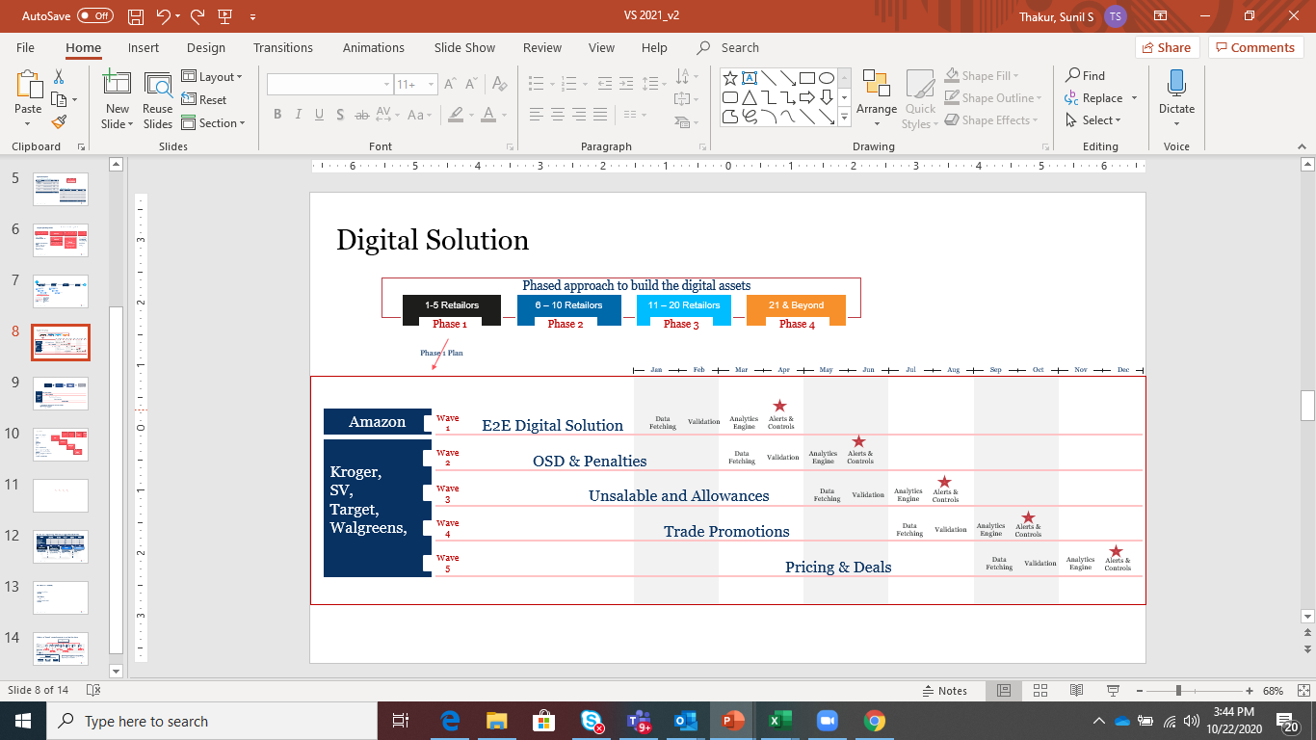
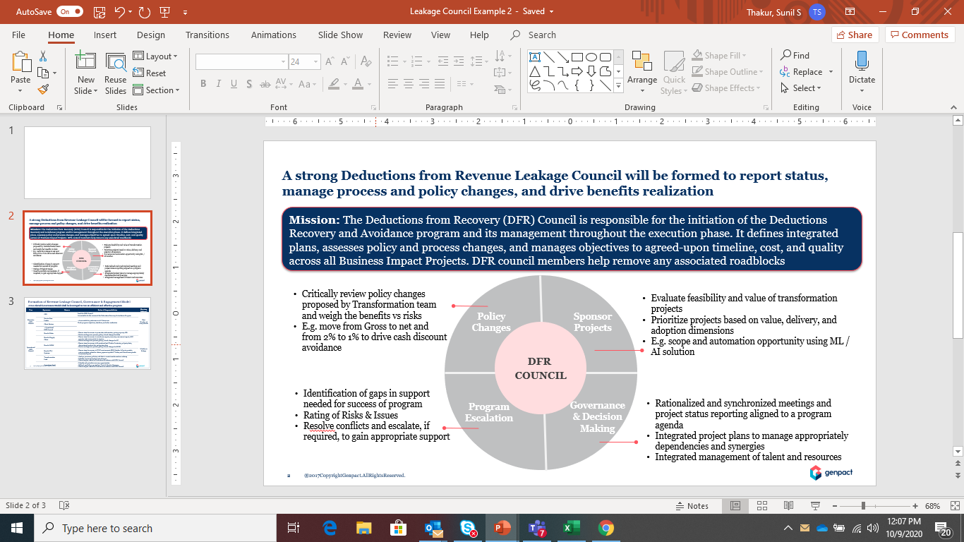
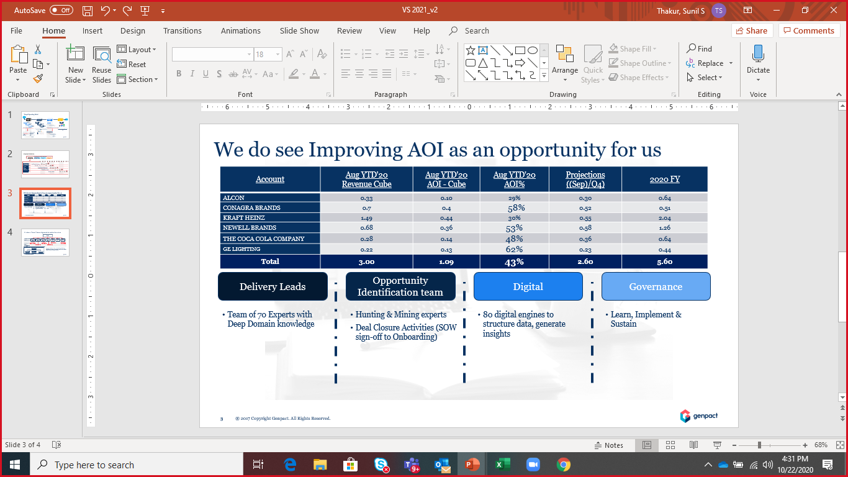
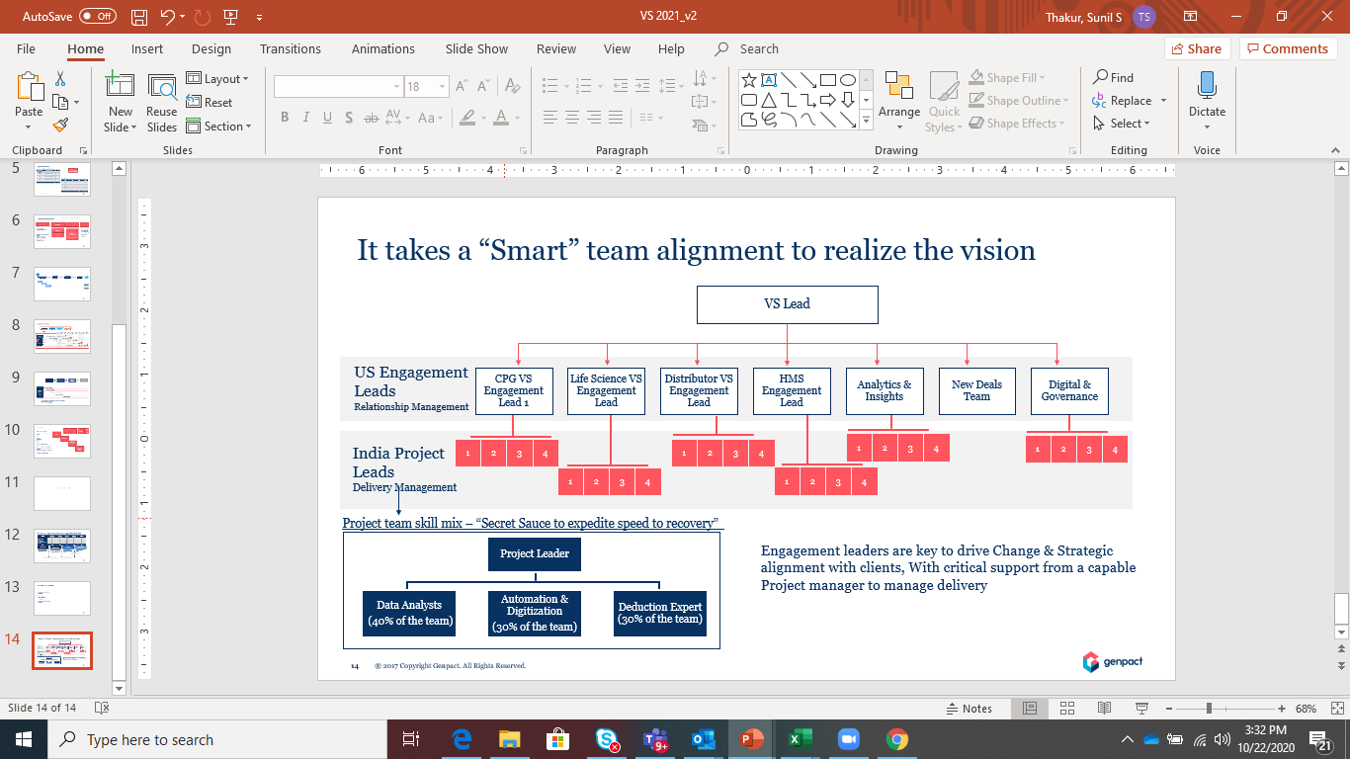
Target Operating Model
2021
Digital Build
Operating Model
AOI
Revenue Leakage Council
$25M
Invest in Digital
Invest to Earn
VS Delivery
Optimize Recoveries
Revenue Leakage Council
Enhanced AOI
Phased Approach
Controlled approach
Land & Expand
Improve Scope
Create Visibility
50%
Digital assets Sell
Elevate Returns
Insights & Analytics Sell
Enhance Revenue
Executive Sponsorship
35%
35%
Stakeholder Engagement
2020
2021
2022
Reinvest 20% back to build sustainable Digi Assets
Visibility & Awareness is key to drive business impact
Enable through smart & focused team
2021 sustain AOI includes digital investments
Growth
VS Delivery
USA Lead – Customer Relationship Manager
Analytics Lead – Insights
Digital & Governance Team
India Delivery Lead
Analysts – Perform Validation
Specialists – Billbacks / Follow-ups
Manual Research for Backups

Slide 16
Leakage Prevention Model

Slide 17
An understanding and overview of Claims Avoidance in context of the overall process of deductions
Transform upstream processes to fix process break-downs that lead to valid but avoidable deductions taken by Retailers from Kraft Heinz
Harness insights from data modelling such as regression analysis, Monte-Carlo simulation to identify & model solutions which lead to further value unlock
Design and implement digital, process and analytics capabilities to streamline processes along with robust measurement system to enable better tracking and governance to allow future claim avoidance

Slide 18
Our approach for Claims Avoidance includes a team of cross functional experts that will identify and execute sustainable solutions
Continuous process to identify reasons and drive solution implementation
Use Analytics & Insights to identify key reason to fix
Create improvement Charter
Establish project governance, roles & responsibilities
Obtain Kraft Heinz resource commitment
Obtain Project Charter Approval
In partnership with Kraft Heinz teams, understand reasons for deductions. Use tools like VSM, GEMBA Walk, etc.
Identify solutions (Process, People, Policy, Digital, Controls)
Build implementation plan
Drive Solution Implementation
Weekly / Monthly project performance report
Periodic benefits & value share tracking
Seek Finance Sign Off post project closure
Through Data Modelling such as Regression analysis, Monte-Carlo simulation, identify 1-2 value unlock areas across retailers
Model potential improvement and build initial hypothesis
Present project charter to joint governance forum & seek approval to start
#Establish & agree on GL code level #benefit tracking process
Obtain budget approval (if needed)
Seek Kraft Heinz & G Finance sign off on potential avoidance
Work with cross functional team of Kraft Heinz and G drive improvement implementation
Any improvements to be done on G operations, will be done by G
Create Improvement Project Charter
Project Management and Benefit Tracking
Identify Solutions for Avoidance
As deductions for identified reason code improve, focus on next reason code or expand to other retailers contributing to high $ deductions
Project Charter Approval is a key milestone and will be used to agree on:
# Baseline – establish 2 years baseline performance at General Ledger level for a specific reason code. Example: for shortage related deduction GL# ABC98563 hit by $1M in 2017 & $2M in 2018
# Benefit Tracking: Post improvement implementation & stabilization, same GL# ABC98563 to be monitored for reduction. Example $.5M hit in 2019 & $1M in 2020. This reduction will be shared between Kraft Heinz & G
Approval on project execution plan and assigning Kraft Heinz resources / stakeholders for execution

Slide 19
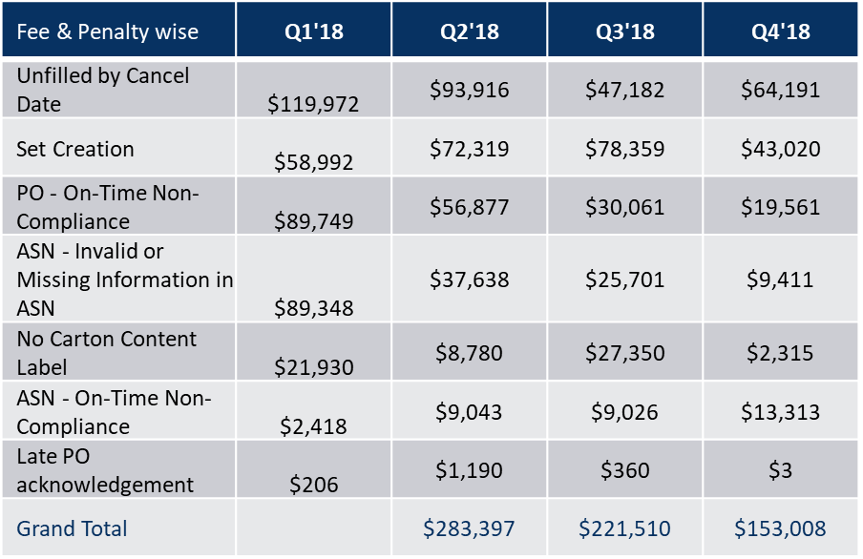
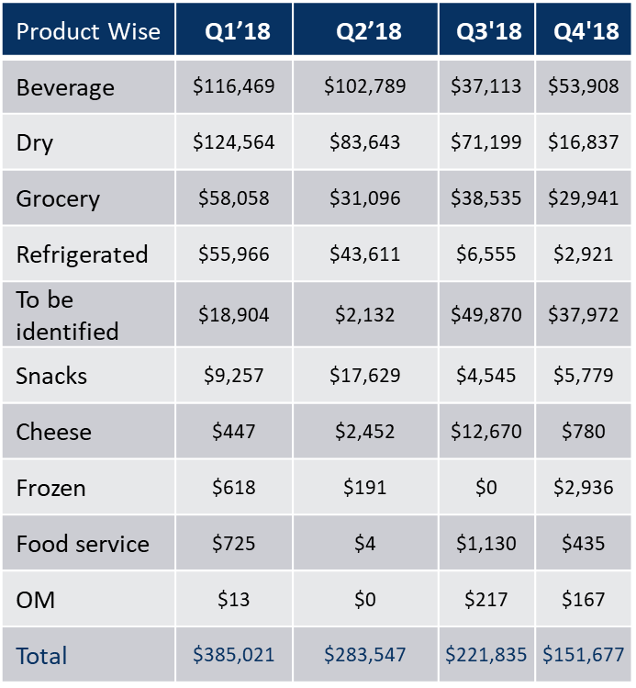
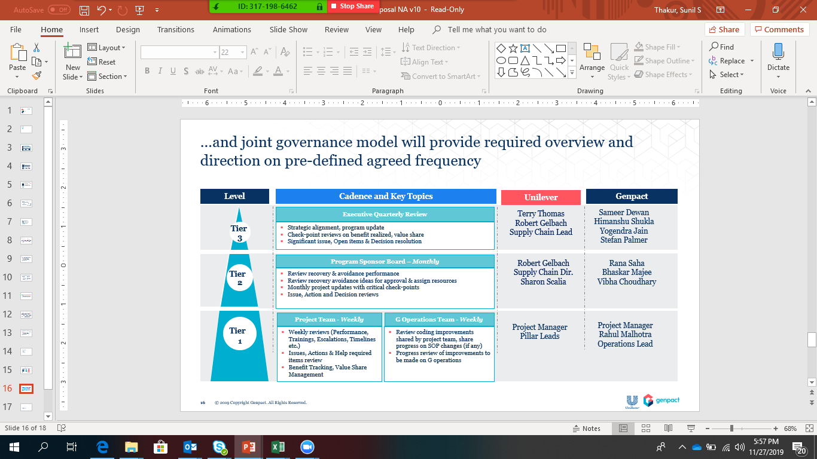
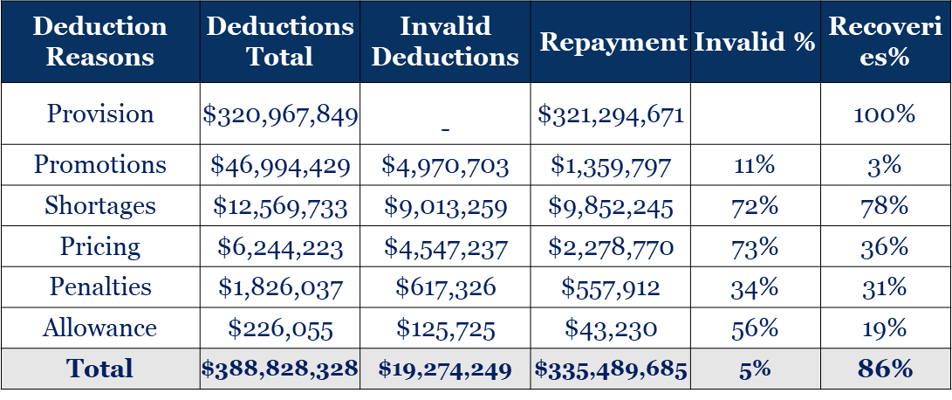
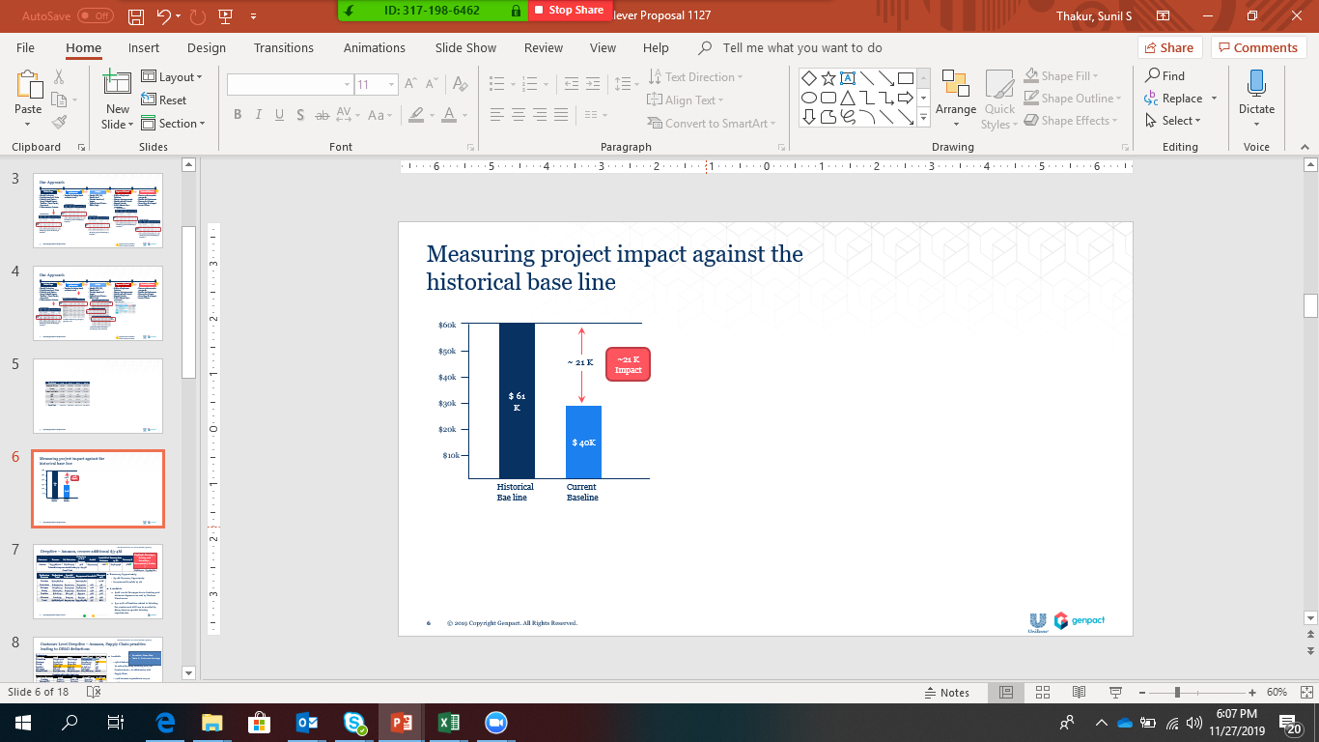
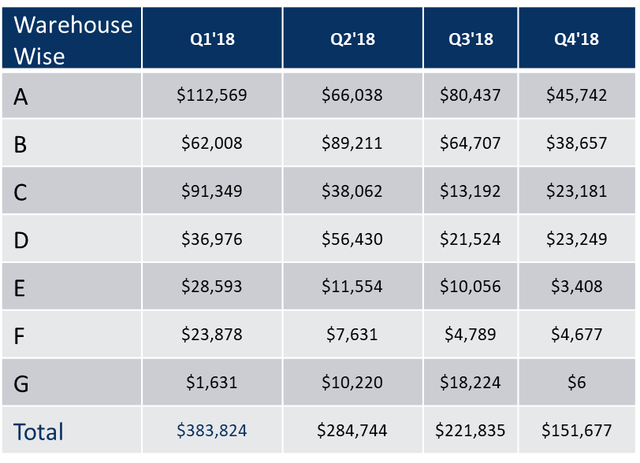
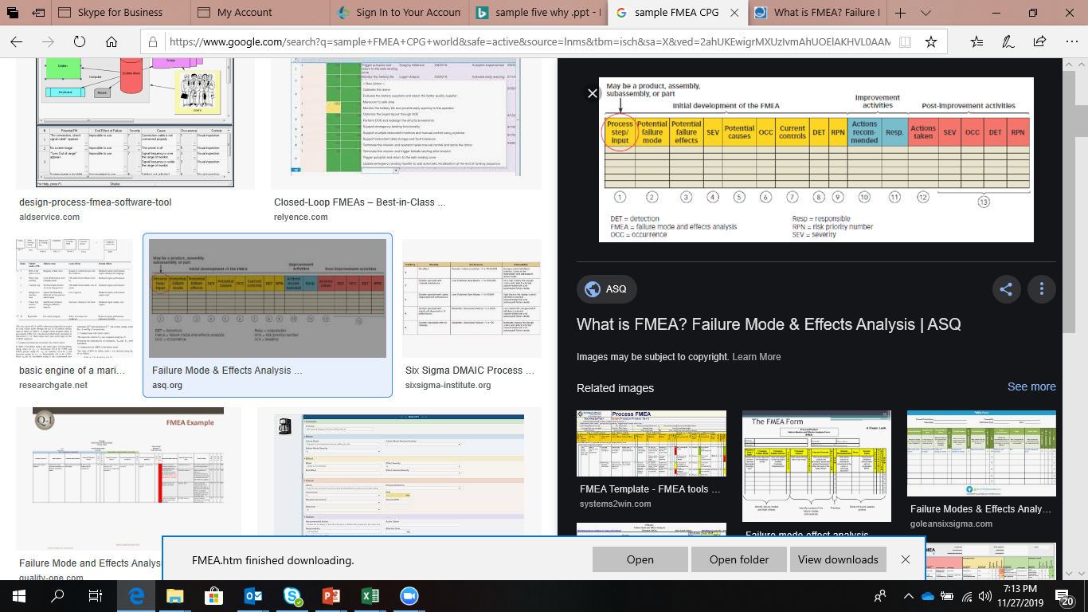
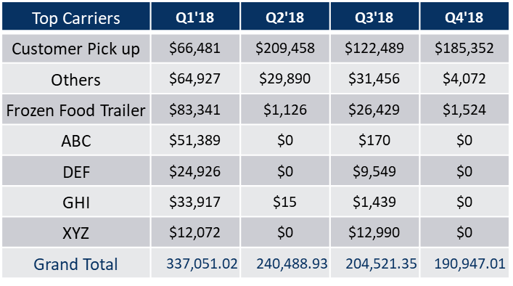
Example of claims avoidance tracking and monitoring
Timeline for Illustration only
wk0
wk1
wk3
wk5
wk8
Q1
Define Scope
Measure historical performance
Analyze
Improve & Control
Sustain & Measure
Identify avoidable deductions
Prioritize based on $ value
Define Project Charter – Scope, Potential Impact, Timelines , Team Charter , Governance
Define measure of success
Baseline the potential recovery based on historic trend
Identify SKU, WH, at retailor level
Prioritize based on $ value
Update Project Charter – Refine Scope
Identify key stakeholders for regression & amplitude analytics and brainstorming
Retailors requirements & Agreements
Build and Implement Solutions
Measure the improvement
Identify risk and controls
Execute Controls
Build & Execute Day 2 governance
Measure performance for one quarter
Baseline the Performance
Measure the $ Impact
Secure Sign off on impact
Invoice G Share
Last 4 Quarters fees & Penalties
Median Value = ~$61K
Day 2 Governance
Overall Deductions
Measuring Impact
Top 3 SKU
Imitative Scope
Top 3 WH
Establish Baseline for top 3 using last 4 Quarters $ value
FMEA – Risk & Mitigants
Supply chain issues contributing to finical leakages :
Incorrect Labeling leading to quantity issues
Inventory counting in WH
Bundling Issues
Placard issues while placing incoming inventories to overages and shortages
Product mixing due to one PO in multiple trucks or Multiple POs in one truck
Top 3 Carriers
Establish project impact through current and historical baselining
Sustain the performance through robust governance
Identify Top SKUs, WH & Carriers contributing to Fines & Penalties
Toll gate read out to governance team

Slide 20
Revenue Leakage Council
Project team to Find out recovery opportunities
Set up monthly Leakage Council
Share Invalid Analytics with Mars Sales Leads
Establish Retailers wise Settlement process
Perform Independent Recoveries
Set up Monthly connect with Sales
Build Visibility on Retailer Specific Issues
Sales to work with retailers to fix Invalid issues
Genpact | Client | Frequency | Agenda
Account GOL | GBS Lead | Monthly | Visibility around Leakages
Client Partner | Sales Head |  | Establish Sales Settlement Process
Value Share lead | Supply Chain Head |  | Establish Controls Around Retailers driven Leakages
Transformation Lead | OM Lead |  | Process & policy related recommendations
Service Line Lead | Transformation Lead |  | Sharing Industry experience & how Genpact helping other clients.
 | Corporate Controller
 | CFO

Slide 21
Realignment and reinforcement of the Org will be critical to adopt new ways of working
Future State
Insights & Effort & Impact
Current State
Mission Based Analytics and Digital Factory
Driving Prevention
Initiatives
Sameer Atrey
(GOL)
Value Share Lead
Monthly Revenue Leakage Council
Project Charters Sign Off
Project Plan & Key Milestones
Communication Plan
Current Base Line
Impact Sign Off
Structured Data
Ops Team
Project Team
Mission Based Analytics and Digital Lab
(GOL)
Approved Prevention
Initiatives
Insights
Project Team
G Program Manager
Validate Insights
RCA & Solutions
Implement Solutions
Measure Impact
Secure Revenue Leakage
Council's sign off on Impact
Insights & Improvements
Ops Team
Refer to annexure slide # x & y for details
Notes:
Bring integrated Operations elements – add page references for all slides with annexure documents
Reporting,
Governance, …Revenue L C with Focus on incremental recoveries & L Prevention (Annexure to have detailed stakeholders page for, Timelines, ) Monthly ,
Program Manager -
Example – Fixed Upstream issues (Refer To Satish’s slide from Vibha ) – Pick one example

Slide 22
Leverage Genpact Partnerships & Advisory Forums
Value Chain | Digital Partners | Genpact Methodology
Trade Forecasting | Ever site
Trade Planning & Execution | Anna Plan
Order Management | Cilonis
Trade Promotions Deductions Validation | Genpact in-house
Deductions Prevention | Genpact – in House – BI Hub & POD’s | Genpact driven DFR Council
Ops Recoveries |  | Genpact driven DFR Council
Write off Recoveries |  | Genpact Value Share Program
Under billing Identification | Genpact- in House – OI deals | Genpact Value Share Program
Genpact Advisory Board | Area of Expertise | Name
Acosta CEO | Sales Execution
Eversite CEO | Future of TP Forecasting | David Moran
Notes:
SAP enhanced coding's recommended by Ops team will help HRC to expedite the exicutions

Slide 23
Retailers Play Book

Slide 24
Retailers Policy
Policy Type | Kroger | SV | DG | Amazon | Walmart | Target | Publix | AWG | Meijer | Costco | CVS | Walgreens
Overall
Notes:
SAP enhanced coding's recommended by Ops team will help HRC to expedite the exicutions

Slide 25
Retailers Requirements
Requirements | Kroger | SV | DG | Amazon | Walmart | Target | Publix | AWG | Meijer | Costco | CVS | Walgreens
On time | Yes | Yes | Yes | Yes | Yes | Yes | Yes | Yes | Yes | Yes | Yes | Yes
Fill rate | Yes | Yes | Yes | Yes | Yes | Yes | Yes | Yes | Yes | Yes | Yes | Yes
Labeling |  |  |  |  |  | Color Codes
ASN | Yes
Bagging
Product shelf life
Barcode
Carton Size
Packaging
Bubble Wrap | NA | NA | NA | NA | NA | NA | NA | NA | NA | NA | NA | NA
Carton Content
Prep Set Creation
Overages
No Show
Taping
Appointment Scheduling |  | yes | yes |  |  | yes
Notes:
SAP enhanced coding's recommended by Ops team will help HRC to expedite the exicutions

Slide 26
Retailers Requirements
Requirements | Kroger | SV | DG | Amazon | Walmart | Target | Publix | AWG | Meijer | Costco | CVS | Walgreens
Price Increase Communication | 30 days | 30 days | 30 days | 30 days | 30 days | 30 days | 30 days | 30 days | 30 days | 30 days | 30 days | 30 days
POD CPU Load |  |  |  | Amazon Responsibility | WM Responsibility
POD Prepaid Load | Signed | Signed | Signed | Signed | Signed | Signed | Signed | Signed | Signed | Signed | Signed | Signed
OSD
Contract Communication (TP) | 90 days Notification | 90 days Notification | 90 days Notiifcation | 90 days Notification | 90 days Notification | 90 days Notification | 90 days Notification | 90 days Notiifcation | 90 days Notiifcation | 90 days Notification | 90 days Notification | 90 days Notification
Freight weight | Gross wt | Gross wt | Gross wt | Gross wt | Gross wt | Gross wt | Gross wt | Gross wt | Gross wt | Gross wt | Gross wt | Gross wt
Freight Rate | Lane wise defined | Lane wise defined | Lane wise defined | Lane wise defined | Lane wise defined | Lane wise defined | Lane wise defined | Lane wise defined | Lane wise defined | Lane wise defined | Lane wise defined | Lane wise defined
Freight due to EDI | Yes |  | NA | Yes | No | No | No | No | Yes | No | Yes | No
Freight due to Super fuel | Yes |  | No | NA | Yes | No | Yes | No | Yes | Yes | Yes | No
Loading/Unloading |  |  |  |  | Yes |  | Yes |  | Yes
Notes:
SAP enhanced coding's recommended by Ops team will help HRC to expedite the exicutions

Slide 27
Retailers Nuances
Requirements | Kroger | SV | DG | Amazon | Walmart | Target | Publix | AWG | Meijer | Costco | CVS | Walgreens
OSD |  |  | Incorrect Receiving Practices, Product Master accuracy | Amazon Labeling Requirements/WH receiving issues | Combined Shipment/WM receiving issues | Product Substitution/Palletization | Publix SKU vs Supplier SKU
Cash Discount
Notes:
SAP enhanced coding's recommended by Ops team will help HRC to expedite the exicutions

Slide 28
Type of Penalties
Requirements | Kroger | SV | DG | Amazon | Walmart | Target | Publix | AWG | Meijer | Costco | CVS | Walgreens
On time
In full
Loading/Unloading
Notes:
SAP enhanced coding's recommended by Ops team will help HRC to expedite the exicutions

Slide 29
Deductions Referencing Patterns
Requirements | Kroger | SV | DG | Amazon | Walmart | Target | Publix | AWG | Meijer | Costco | CVS | Walgreens
Promotions | XXX-R-XXX XXX-C-XXX | 7-10 digit – Scan down 17-23 digit - Promotions
OSD | Invoice # | Invoice # |  | Invoice # end with SC | Invoice # | Begins with CB | Invoice # | Invoice # |  | Invoice # | Invoice # | Invoice # end with C
Pricing | Invoice # | Invoice # |  | Invoice # end with PC | Invoice # | Begins with CB | Invoice # | Invoice # |  | Invoice # | Invoice # | Invoice # end with C
OI deals | Invoice # | Invoice # |  | Invoice # end with SC | Invoice # | Begins with CB | Invoice # | Invoice # |  | Invoice # | Invoice # | Invoice # Ends with C
Allowance | Invoice # | Invoice # |  |  | Invoice # |  | Invoice # | Invoice # |  | Invoice # | Invoice # | Invoice # Ends with C
Penalties |  | 7-10 digit |  | Ends with CBINV |  | Begins with VC0, VC1
Unsalable | XXX-V-XXX | 7-10 digit |  |  |  | Begins with 501-XXX |  |  |  | Begins with RV-XXX
Notes:
SAP enhanced coding's recommended by Ops team will help HRC to expedite the exicutions

Slide 30
Kroger

Slide 31
Kroger's Goal – Best Practices
Goal: Reducing Damaged Product | There are two best practices to be implemented during the palletization and loading process: "CHEP" pallets are the preferred pallets to be used on all palletized product. If "CHEP" pallets are not available, then pallets of the GMA standard should be used (GMA specification below). "CHEP" pallets will help in reducing damages due to the fact that each pallet is put together based on consistent specs for the wood strength and placement of the top, bottom and stringer boards. Many times product that is placed on a non-CHEP pallet arrives damaged due to the pallet boards breaking in transit or the space between the top boards is too great thus allowing cases of product to fall between the boards. GMA Pallet Specifications: 1. GMA, Grade A, 4 way pallets, 48” X 40” parts and side of parts must be identical to descriptions in picture provided. • Material-Group III or Group IV hardwood clean saw • Grade-to be good sound material free of Knots larger than 1/3 the width of the board. Boards are to be free of serious imperfection which would result in total pallet failure. • Nailing-Nail item #2 and #4 to item #1 with three 8-D 2-1/2” driver screw nails well staggered at each nailing joint. Nail item #3, #5, to item #1 with two 8-D 2-1/2” driver screw nails well staggered at each nailing joint. • Notching-All three stringers to be notched in two places 1-1/2” deep X 9” long with a 3/4 “curved corner radius. 2. No Missing or Broken Boards on top or bottom 3. No double stringers, patched boards or metal repair plates 4. All stringers to be solid, not broken and/or have cracks visible from three sides and longer in run than one inch. Weathering cracks which are not continuous and not visible from three sides are allowable. 5. Pallets are not required to be bleached white but should be clean and odor free. Clean pallets are free of debris and satins. Discoloration due to aging is acceptable. 6. No cracks on top or bottom boards greater than 1/8” wide and 15 inches in length. 7. No exposed splinters greater than 3 inches in length. 8. No Tapered breaks with a depth of greater than 1 inch along a ten inch or more run. If at the ten- inch distance the depth is less than one inch, the pallet is good. If the one-inch depth runs the entire length of board the pallet is unacceptable. Much have chamfered bottom boards. Loading Methods The "side by side" pallet loading method will be used for all commodities, except Strawberries and variety berries. The side by side method can be accomplished by loading each pallet on the 48" front on each side of the trailer, rather than the 40" front. Loading the product "side by side" will prevent the side to side shifting of product thus reducing damaged cases upon arrival. All berries will be loaded based on the "pinwheel" loading method. The pinwheel method can be accomplished by loading one pallet on the 48" front and the next pallet loaded on the 40" front. A minimum of two “ratchet” type Load Locks should be used to help secure the last two pallets. One Load Lock should be positioned horizontally near the top layer of product and the other Load Lock should be placed approximately two feet lower.
Notes:
SAP enhanced coding's recommended by Ops team will help HRC to expedite the exicutions

Slide 32
Kroger's Goal – Best Practices
Goal: Reducing shortages | A best practice to be implemented will be to have the shipping function (whoever is responsible for loading the product onto our trucks) input the actual number of cases of each product loaded, into the iTrade Network system at the actual time of loading. Using the iTrade Network system at the time of loading will help in reducing shortages, since our receiving function defines a shortage as the difference between the quantity received and the quantity entered into the iTrade Network system at the actual time of loading.
Notes:
SAP enhanced coding's recommended by Ops team will help HRC to expedite the exicutions

Slide 33
Retailers Requirements
Requirements | Requirement 1 | Requirement 2 | Requirement 3 | Requirement 4 | Requirement 5 | Requirement 6 | Requirement 7 | Requirement 8 | Requirement 9 | Requirement 10 | Requirement 11
Price Policy | 90 days prior effective date - General Merchandise (Excluding Commodity) | 45 days prior effective date Kroger branded (PVT labeling) | 30 days prior effective date (all other items) | Kroger wont accept & pay if prices not paid with in timelines mentioned in requirement 1-3
Accounting Policy | Unique Invoice # | Valid Kroger PO | Vendor Name | Remit to Adrress | Complete address for order shipped | Net Payment – subject to CD | Payment terms | Total Shipped quantity | Total Order quantity/Invoices | Invoice date | Shipped date
Non Compliance | ASN Incorrect | Case Labeling Errors | Case Pack Errors | Non Confirming – GSI-128 labels | Hazardous material not properly labeled | Improper Hangers | Hazardous product not registered in WERCSmart | Improper or no Hazardous Material shipping papers when required | Items discontinued without 60 days written notice | Failure to deliver /Missed appointment/delivery | Late or incorrect ad merchandise
Fee | $500 | $200 | $500 | $500 | $500 | $500 | $500 | $1000 | $1000 | $200 | $1000
Non Compliance | Early. Late shipment | Failure to mark cartons/Bills of Lading with correct, complete shipping address. | New products not in inventory at distribution center after item availability date | Manufacturing raw material supplies not available to Kroger on the mutually agreed upon date. | EDI within 90 days – not conducted by vendor | Not following Traffic Department routing instructions (CPU) | Not Providing the Unloading services on Prepaid shipment | Packing list Errors | Poor Pallet Quality
Fee | $500 | $200 | $1000 | $1000 | 1% of invoice or $250 (whichever is >) per PO | $250 | $250 | $200 | $100
Notes:
SAP enhanced coding's recommended by Ops team will help HRC to expedite the exicutions

Slide 34
Deductions Referencing Pattern
Requirements | Kats Promotions | Coupons Promotions | Post Audit Promo | Others | NCH Coupons | Repayment Referencing Single Payment | Repayment Referencing Bulk Payment
Promotions | XXX-AXXXX-XXX Example: 181-A223908-021 | XXX-CXXXX-XXX Example :060-C745153-660 | XXX-RXXXX-XXX Example - 092-R966814-388 | P000XXXXX –Example : P0033346701 | Begins with C000 Example : C000642443
Reasons | Patterns | Repayment Referencing Single Payment | Repayment Referencing Bulk Payment
OSD | Invoice # | Invoice # end with R or begins with PB | NA
Pricing | Invoice # | Invoice # end with R or begins with PB Example :PB0032654063 | Any Invoice # part of group/end with R or begins with PB Example :PB0032654063
OI deals | Invoice # | Invoice # _LXXXX Example: 0032285514_L51211 | NA Any invoice #_LXXXX
Allowance | Invoice # | Invoice # end with R or begins with PB Example :PB0032654063 | NA
Penalties | On-time – XXX-G-XXX Example: 796-G1913-19961 In Fill – XXX-NC-XXX Example: 701-NC-00073608 | Same Reference “Tarde Promotions Details” | Same Reference Joint – Information available on Kroger's Portal “Tarde Promotions Details”
Unsalable | XXX-V-XXX | XXX-V-XXX | XXX-V-XXX

Slide 35
Supply Chain Logistics Requirements
Compliance | Requirements
Case Fill Rate | Orders will be subject to a Case Fill Rate metric, measured as the percentage of items on a purchase order that were filled in full. Orders that do not meet these requirements will be subject to a non-compliance fee.
ORAD Compliance | Purchase orders arriving after the original requested arrival date (ORAD) will be subject to a non-compliance fee
On time compliance | Purchase orders arriving more than two hours before or more than thirty minutes after the appointment will be subject to a non-compliance fee
Long term Product Unavailable | If product becomes unavailable (ex. ingredient or packaging issues, production problems, recalls, forecasting errors, etc.), it is critical that the supplier provides Kroger with accurate recovery information so that we can decide how best to manage the issue. In the event that Planograms have to be reset due to long-term product unavailability, a service charge will be assessed based on the KOMPASS Policy
UPC/GTIN Policy | All Products sold to Kroger in consumer units for the purpose of resale must have a readable UPC or GTIN (“UPC”) barcode affixed to the Product or the Product’s “sellable” packing. The exceptions are items that have been declared exempt, such as newspapers, bulk items, produce, etc. All produce sold to Kroger must have a PLU code affixed to the Product. See your Kroger Representative for further clarification. Vendor must adhere to the UCC specifications for the UPC bar code for format, size, color, location and clarity. Bar codes must be clear, legible, scannable and represent the human readable numeric code located beneath the barcode. Vendor must e-mail its Kroger Representative for authorization prior to making substitutions for the Products appearing on the Kroger Purchase Order. Vendor must communicate to its Kroger Representative, in writing, all changes to current UPC numbers, as well as the addition of new numbers, no less than ninety (90) days prior to shipment of Products to Kroger. Vendor covenants that: 1) the UPC on the labels or packaging for all Products will be imprinted in an accurately scannable manner; and, 2) the UPC information will be correctly assigned to the Products. For the breach of either or both of these covenants, Kroger will charge the Vendor in accordance with the Non-Compliance Fee Schedule. As technology changes, Vendor agrees to adhere to any additional labeling or identification requirements that Kroger requires.
Notes:
SAP enhanced coding's recommended by Ops team will help HRC to expedite the exicutions

Slide 36
Supply Chain Logistics Requirements
Compliance | Requirements
Product Regulatory requirements | Kroger utilizes WERCSmart by Underwriters Laboratory (UL) to manage regulatory compliance requirements for all chemical-containing products, aerosols, batteries, battery-containing products, electronics, pesticides, over-the-counter pharmaceuticals, personal care products, and other potentially hazardous products. Our suppliers must carefully read the Kroger WERCS’ Supplier Letter and register affected products, including private label products, in WERCSmart. Contact wercsinfo@kroger.com with any questions
Case Labeling | Minimum requirements for case labeling may differ, depending on the following factors: ❑ Product category ❑ Sourcing (domestic vs. import) ❑ Facility shipped to ❑ Usage of carton level GS1-128 label with approved ASN Printing must be legible, and easily visible in a warehouse environment (at least 4 feet from the product). Preprinted or pressure sensitive labels may be used in lieu of direct ink application. Case labels to be positioned so they are visible from the outside of the finished pallet. Any applied label must meet content, positioning, and legibility requirements set forth in this standard. All cases must display the following: ❑ Case GTIN/Barcode – the barcode must be scan readable according to GS1 standards. ❑ Product GTIN number in human readable format. ❑ Product name, including brand ❑ Pack count and size ❑ Code date (best by, sell by, etc.) The shipping case must be printed with the same date code as the retail package. Open dating is required on all packages. ❑ Label hazardous substances in compliance with the Federal hazardous Substance labeling act and transportation method: I.D.T.A., DOT CRF-49, I.M.D.G. as may apply.
Product Preparation | Vendor must prepare Products for shipment as specified by the Kroger Purchase Order instructions, I.D.T.A., DOT CRF-49, I.M.D.G. requirements, and in accordance with the Terms and Conditions of the National Motor Freight Classification as it pertains to specifications for packages and the rules portion of the tariff. ❑ Apply tickets to product in accordance with the Kroger Purchase Order, including any specific ticketing provisions and cost thereof: ❑ Print the correct information on the ticket (e.g., price, SKU, Class, UPC). ❑ Place ticket on the correct Products. ❑ Place ticket in the correct location on the Products. ❑ Apply hangers as specified by the Kroger Purchase Order, per the Hanger Requirements information found at the Fred Meyer Business to Business website: https://www.fredmeyer.com/topic/business-to-business: ❑ Proper color. ❑ Proper size and type. ❑ Size indicator properly applied. ❑ Custom pre-pack and package Products as specified by the purchase order: ❑ Case quantity and inner pack quantity as specified. ❑ Correct number of units. ❑ Pre-assorted as specified. ❑ Do not ship partial cases.
Notes:
SAP enhanced coding's recommended by Ops team will help HRC to expedite the exicutions

Slide 37
Supply Chain Logistics Requirements
Compliance | Requirements
Packing List | Vendors are required to prepare packing lists as specified below: 13 ❑ Prepare a packing list for each Kroger Purchase Order to include the Kroger Purchase Order number, Vendor style/stock number, UPC, quantity ordered, quantity shipped, and customer address. Note: Softgoods Products packing lists must also include the UPC/SKU number, color, size and the total quantity shipped by style. ❑ Clearly indicate which carton contains the packing list. Note: If agreed upon, prepare individual store packing lists and a consolidated packing list when shipment is specified for multiple stores. Attach paperwork to the lead carton. ❑ Indicate the quantity and cost of pallets if Products are delivered on pallets for which Kroger will be charged.
Code Date Guidelines | Minimum shelf life and Code Date requirements are required for all Grocery, HBC/Natural Foods, packaged Produce, packaged Deli/Bakery and packaged Meat/Seafood products entering our Distribution Centers. Minimum and maximum shelf life is required on all New Item forms. Code Date Requirements are shown below: The Code Date (item and case) guidelines for all products & net weight items include: ❑ Type of Code Date ▪ Open date (Sell by, Best Before, Expiration, Use By) ❑ Location ▪ Perishable items (<60 days) should have the code date printed on the Primary Display Panel (ideally top right quadrant,) depending upon space. ▪ Code Date for non-perishable items should be printed on an easily-viewable location (consistent with category norms) ❑ Text ▪ EASILY readable ▪ Same size as panel text (package graphics) depending upon packaging and label limitations ▪ Minimum of 12-point font depending upon packaging and label limitations ▪ Contrast between text color; background must be legible ▪ Case Pack printing must be legible, and easily visible in a warehouse environment (at least 4 feet from the product). ❑ Shelf Ready Packaging ▪ Code Date on the front of the package and on the product ❑ Multi-use Items ▪ Code Date should not be printed on packaging that is removed when the product is opened (lid or tear strip). Code Date should be printed on the inner packs and consumer units ❑ Single-use Items (i.e. single serve yogurt) ▪ Code Date on lid is acceptable placement
Product Packaging | Vendor will comply with all reasonable ergonomic requirements established by Kroger and provided to Vendor, including but not limited to those pertaining to packaging weights, carton dimensions and handhold requirements. Vendor will utilize secure clamshell packaging to better protect high theft Products if requested by Kroger.
Notes:
SAP enhanced coding's recommended by Ops team will help HRC to expedite the exicutions

Slide 38
Supply Chain Logistics Requirements
Compliance | Requirements
Routing & Shipping Instructions | Vendor will list all Kroger Purchase Order numbers on the Bill of Lading. (This service may be performed by the carrier on the freight bill.) 15 ❑ Mark all cartons and Bills of Lading with complete shipping address. Pack, mark and describe shipment on Bill of Lading in accordance with the National Motor Freight classifications, including I.D.T.A., DOT CRF-49, I.M.D.G. ❑ Call Kroger’s Logistics Department for correct routing instructions on FOB origin shipments when the shipping point will be other than that shown on the Kroger Purchase Order. Any excess charges due to Vendor’s failure to do so will be charged to Vendor. ❑ Provide Kroger with a contact name, address, and phone number, for each of Vendor’s ship points, to receive updates to standard routing instructions. ❑ Follow the Kroger Logistics Department standard routing instructions for all collect shipments. ▪ Kroger Routing Instructions are found at: http://www.thekrogerco.com/vendors-suppliers/document-library ▪ For Fred Meyer routing information, please visit: http://www.fmroutinginstructions.com/general.htm? ❑ Ship Products according to the date specified on a Purchase Order. Prepaid orders are expected to arrive on the ship-to-arrive date and collect orders are expected to adhere to the ship-cancel window specified on the Purchase Order. Products shipped to arrive after the cancel date (without written prior-approval by the Kroger Representative) are considered non-compliant and are subject to a non-compliance base fee charge. Products shipped to Peyton that arrive before the “due on” date are also non-compliant. ❑ Ship Kroger Purchase Orders complete in one departure – backorders are not allowed unless the Kroger Representative gives prior written approval. Failure to do so will result in a chargeback for shipping costs associated with a backorder. ❑ Ship pre-approved backorders prepaid, FOB our dock at FOB Vendor expense plus applicable off invoice amounts. Kroger covers marine insurance under its open marine policy on FOB origin shipments only. Any added costs caused by Vendor not following Kroger’s instructions will be charged to Vendor
Notes:
SAP enhanced coding's recommended by Ops team will help HRC to expedite the exicutions

Slide 39
Supply Chain Logistics Requirements
Compliance | Requirements
Scheduling & Delivering , Unloading Pallets requirements | For prepaid Vendor shipments, a delivery appointment is required to deliver into the distribution center. Vendor name, Kroger Purchase Order number, delivery address, carrier name and pertinent load information is required for appointment and delivery. This includes number of cases, weight, number of pallets and cube, if available. Load type should be identified i.e. floor stacked, slip sheets or pallets. It is the vendors’ responsibility to schedule a delivery appointment with enough time to meet the Original Requested Arrival Date (ORAD). To facilitate scheduling of inbound delivery appointments, Vendor and its shippers and carriers must use One Network Enterprise’s online web-based scheduling www.onenetwork.com. Delivery appointments can be scheduled off line at a Kroger scheduling center. Kroger reserves the right to impose a fee for any manual scheduling. The facility in Chehalis, WA and the General Merchandise facility in Clackamas, OR are currently unable to use One Network; appointments must be made by phone for these locations. Fees will not be imposed for these appointments. See the General Routing Instructions for more details. Unloading for any type of shipment (floor stacked, slip sheets, pallets) will be based on Kroger’s specifications and at Vendor’s expense. ▪ Palletized loads must be on 48x40 4-way entry block pallets. ▪ Kroger will not participate in pallet exchange programs or pallet bank programs. Pallets are considered part of the cost of goods. ▪ Kroger participates in pallet pooling programs. ▪ If Products are not shipped on a pool pallet, like CHEP, iGPS or PECO then ONLY- #1/A GMA quality pallets will be accepted. ▪ Vendor is responsible for ensuring that imported wooden pallets are treated and marked in accordance with US and IPPC regulations. ▪ Kroger reserves the right to refuse Products shipped on pallets that do not meet minimum standards of quality, safety or sanitation. ▪ Kroger may require Products to be converted to acceptable pallets at the Vendor’s or carrier’s expense. Scheduling and delivery contact information may be found at http://www.thekrogerco.com/vendors-suppliers/document-library.
Returns | Shipping terms for returned Products are FOB Kroger’s designated location, freight collect.
Salvage | Vendor must sign and return to its Kroger Representative a Reclamation Agreement. Vendor must update this agreement when major line changes occur, but no less than annually. Current agreements will remain in effect until changed in writing. Vendor will comply with the terms of the Kroger’s Reclamation Policy. In addition, Fred Meyer stores will conduct a bi-annual Reclamation True-up for nonfood products including Health and Beauty Aids and Candy. This process will compare the Vendor’s actual product processed through the Fred Meyer Reclamation Center compared to the monies collected from the Vendor as a Reclamation Allowance. If the Vendor’s Reclamation Allowance is less than the product processed through Fred Meyer’s Reclamation Center, then Fred Meyer is entitled to claim the variance, via an Accounts Receivable invoice or a deduction.
Notes:
SAP enhanced coding's recommended by Ops team will help HRC to expedite the exicutions

Slide 40
Supply Chain Logistics Requirements
Compliance | Requirements
Case Packaging | Using advanced automated technology systems; Kroger is changing the way Products are handled within some of its distribution processes. With these automated systems, pallets are received and inducted into the system in a uniform manner. Subsequently, each case flows through the same standardized processes throughout the system. The system’s output is a mixed SKU pallet, ready for delivery to retail stores. Both pallets of Products and case units supplied by Vendor must be able to flow through this system without causing any errors or interruptions to the system process. If errors occur routinely with specific SKUs, packaging or pallet configuration changes may need to be made by Vendor. Vendor must comply with the pallet, case and slip-sheet/tie-sheet specifications established by Kroger for Products handled by its Case Handling Automation System. A copy of these specifications can be found at https://www.thekrogerco.com/vendors-suppliers/document-library/
Display Guidelines | Vendor will comply with the Kroger Display Guide parameters, a copy of the Kroger Display Guide can be found at https://www.thekrogerco.com/vendors-suppliers/document-library/
Customer Pick up fuel allowance policy | Vendor must provide Kroger a diesel fuel allowance on all Kroger managed shipments of Products in accordance with the Customer Pickup Fuel Allowance Policy set forth below: Kroger requires all Vendors to provide a ‘fair and equitable’ market-based Customer Pickup (“CPU”) diesel fuel allowance on all Kroger managed shipments of Products. This allowance should be applied to each individual Kroger Purchase Order invoice. In the event Vendor is unable to reflect applicable fuel surcharge either as an additional line item or as part of the agreed upon customer pick-up allowance on the individual Kroger Purchase Order Invoice, the total allowance amount will be based on the U.S. Government’s weekly Department of Energy’s (“DOE”) National Diesel Fuel Index. Calculation logic is as follows: ❑ Miles are calculated between origin and delivery location zip codes using PC Miler. ❑ The Kroger Purchase Order pickup date will be cross-referenced to the U.S. Government’s D.O.E. Weekly National Diesel Fuel Index to pinpoint the price of diesel fuel for each individual backhaul shipment. http://tonto.eia.doe.gov/oog/info/wohdp/diesel_detail_report.asp ❑ The D.O.E. Weekly Diesel Fuel Index price per gallon is then cross referenced to Kroger’s CPU Fuel Index Scale to determine the weekly fuel subsidy per mile. ❑ Kroger’s DOE fuel index scale’s “neutral zone” is $1.15--$1.1999. Every +/- $.05 change in the National DOE Index will equate to +/- $.01/mile vendor fuel allowance per backhaul shipment. Kroger’s scale is uncapped. ❑ The Kroger Fuel Index Scale will be multiplied by each Kroger Purchase Order’s total mileage to determine total $$ subsidy applied to each Kroger Purchase Order invoice
Notes:
SAP enhanced coding's recommended by Ops team will help HRC to expedite the exicutions

Slide 41
Case Labeling Requirements for General Merchandise
Compliance | Requirements
Case Labeling for General Merchandise | The following case labeling is required unless a GSI-128 carton label meeting Kroger specifications is used with an approved ASN transmission. Label cases legibly, as required, to include the following information: ❑ Kroger name, address and Kroger Purchase Order number. ❑ Vendor name and invoice number. ❑ Vendor style/stock number (list all styles in mixed cases). ❑ Case-pack information by style, size breakdown, color, quantity, and lot code. ❑ For Softgoods Products, mark the carton number and the total number of cartons on each carton in multiple carton shipments. (For example: 1 of 26, 2 of 26, etc.). Note: If Products are one full pallet of the same item (all the same SKU), only one case label per pallet is required, unless shipping to the Chehalis Retail Service Center. Label hazardous substances in compliance with the Federal Hazardous Substance Labeling Act and transportation method; I.D.T.A., DOT CRF-49, I.M.D.G. as may apply. Vendors shipping product to other Distribution Centers should contact their Kroger representative for the appropriate case labeling requirements for that Center. KROGER IMPORTED VENDORS For products imported by Kroger please see specific information in the Import Shipping Manual, located on-line at https://www.thekrogerco.com/vendorssuppliers/import-vendors/ DOMESTIC VENDORS Shipping to Fred Meyer Retail Service Center, Chehalis, WA: Conveyable, store-ready cartons Minimum: 3” H x 6” W x 9” L, at least 2 lb Do not mix SKU’s in cartons without approved ASN and GS1-128. Please place the carton label on the long side or top of carton, ensuring that the barcode does not wrap around a corner or cross over the seam between box flaps. With approved carton level ASN/GS1-128 label ❑ Packed and marked for stores ❑ Full case marked for DC Note: Email EDIBIZ@fredmeyer.com for testing and approval of ASNs and GS1-128 labels. Mapping, program descriptions and GS1-128 label specs at https://edi.kroger.com (‘Programs & Requirements’) Without approved carton level ASN/GS1-128 Basic carton marks ❑ Kroger/Fred Meyer name, address and Kroger/Fred Meyer Purchase Order number ❑ Vendor name and invoice number ❑ Vendor style/stock number ❑ Case-pack information by style, size breakdown, color, quantity and lot code. ❑ Mark the carton number and the total number of cartons on each carton in multiple carton shipments. (For example: 1 of 26, 2 of 26, etc.) ❑ UPC/GTIN or Fred Meyer SKU Barcode (from the EDI PO) • Barcodes must be at least 2cm tall and 4cm across • We accept four symbologies: UPC-A, Interleaved 2 of 5, Code 128, UCC/EAN 128 • Barcodes must be unobscured, and printed clearly enough to scan consistently For approval and information, please email EDIBIZ@fredmeyer.com. Non-conveyable goods, master packs with non-conveyable inner packs. Includes product shipping to 226 or 234 Maurin Road addresses: ❑ Kroger/Fred Meyer name, address and Kroger/Fred Meyer Purchase Order number ❑ Vendor name and invoice number ❑ Vendor style/stock number. ❑ All inner packs must have scannable UPC/GTIN or SKU barcode). ❑ Case-pack information by style, size breakdown, color, quantity and lot code. ❑ Mark the carton number and the total number of cartons on each carton in multiple carton shipments. (For example: 1 of 26, 2 of 26, etc.) ❑ Label hazardous substances in compliance with the Federal Hazardous Substance Labeling Act and transportation method; I.D.T.A., DOT CRF-49, I.M.D.G. as may apply. Shipping to Fred Meyer Clackamas General Merchandise Distribution Center Basic Carton Marks: ❑ Kroger/Fred Meyer name, address and Kroger/Fred Meyer Purchase Order number ❑ Vendor name and invoice number ❑ Vendor style/stock number (list all styles in mixed cases) ❑ All inner packs must have scannable UPC/GTIN or SKU barcode. ❑ Case-pack information by style, size breakdown, color, quantity and lot code. ❑ Mark the carton number and the total number of cartons on each carton in multiple carton shipments. (For example: 1 of 26, 2 of 26, etc.) ❑ Case UPC/GTIN Barcode • Barcodes must be at least 2cm tall and 4cm across • Kroger accepts four symbologies: UPC-A, Interleaved 2 of 5, Code 128, UCC/EAN 128 • Barcodes must be unobscured, and printed clearly enough to scan consistently ❑ Note: If Products are one full pallet of the same item (all the same SKU) only one case label per pallet is required. ❑ Label hazardous substances in compliance with the Federal Hazardous Substance Labeling Act and transportation method; I.D.T.A., DOT CRF-49, I.M.D.G. as may apply. ❑ FedEx or UPS shipments must include either a packing slip for the contents of each package or an approved GSI-128 label on each package, along with the EDI transmission of an approved Advanced Ship Notice (“ASN”)
Notes:
SAP enhanced coding's recommended by Ops team will help HRC to expedite the exicutions

Slide 42
Kroger Billing Policy for Recalls & Withdrawals
In the event of any and all product recalls that are either (i) agreed upon between Vendor and Kroger, or (ii) that are required (either by law or in the commercially reasonable judgment of Kroger) because Kroger has reason to believe the Products are defective, dangerous, incomplete, infringe upon intellectual property rights, or are not in compliance with applicable laws or regulations, the Products will be returned to Vendor at Vendor’s expense, or otherwise disposed of as provided for in the Kroger Product Recall Procedures. This expense, unless otherwise agreed in writing between Vendor and Kroger, will be as set forth below. Agreed upon returns of slow sellers, overstock, and product recalls that result from defective, dangerous or incomplete merchandise will be returned to Vendor at Vendor’s expense. This expense for the divisions serviced by the Clackamas Reclamation Center, unless otherwise agreed, will include: 1) a 12% handling fee for product consolidation and 2) incoming and return freight charges. Any exceptions to this policy must be in writing and signed by the Kroger Representative prior to the return.
Vendors of recalled or withdrawn Products removed from sale, returned for refund, used in the preparation of other products, or where use of this product may have resulted in potential contamination of other products on display, or will be in the preparation of other products will be charged the total of the following:
Delivered Cost of Products | Cost of Products will be billed using the most recent FCB cost, multiplied by the number of retail units submitted through the Quick Recall application. Products used in additional in-store preparations shall be billed at the finished product cost. Product costs for cases pulled from Distribution Centers will be billed separately by each DC.
Administrative Cost | Divisions Administrative costs will be based on the number of stores included in the recall multiplied by 20% of the fair wage rate established by each Kroger Division. Class I recalls are calculated using a 30% rate to reflect the more intense follow-up required for those recalls. Distribution Centers Class I Recall - $500 per recall Class II Recall - $300 per recall Class III/Recalls/Withdrawals - $200 per recall/Withdrawal General Office Administrative Costs In addition, any General Office administrative costs associated with IVR and register tape messaging shall be billed to Vendor on a cost per occasion basis. 3
Store Handling Cost | Store labor costs will be based on the time each store spends on the recall/withdrawal (one hour minimum) multiplied by the fair wage rate established by each Kroger Division. Time includes receiving the recall/withdrawal, checking shelves, back stock, markdowns, Online orders waiting for pickup or delivery, incoming shipments, posting signs, notifying front desk personnel, responding to the recall/withdrawal through the application, scanning out product to adjust inventory, etc.
Notes:
SAP enhanced coding's recommended by Ops team will help HRC to expedite the exicutions

Slide 43
Kroger Billing Policy for Recalls & Withdrawals
Warehouse Handling Cost | Use average warehouse rate, including fringes, multiplied by the total number of hours involved. (Must be documented with accurate records).
Shipping Cost to Stores | If Kroger Division is requested to return products, use cents per cwt. cost for shipping that product category times cwt. shipped to stores and also from stores.
Actual Freight for Products Returned | Returned Charge the actual freight cost for the products returned to Vendor, if Kroger has to arrang
Disposal Cost | Charge any identifiable disposal costs.
Special Handling Cost | Charge any identifiable special handling costs.
Customer Refunds | Charge any customer refunds for returned Products.
A record of each transaction is necessary for charging the handling and product costs back to Vendor. Any replacement merchandise must be billed to the Operating Division by Vendor as new merchandise. (Trading merchandise without a charge or credit in the store or in the warehouse is not permissible.)
Notes:
SAP enhanced coding's recommended by Ops team will help HRC to expedite the exicutions

Slide 44
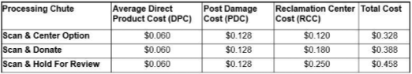
Reclamation Policy
It is Kroger’s goal to minimize waste and the use of landfills to the greatest extent possible. To facilitate these goals, The Kroger Co. will no longer destroy unsalable product except in extraordinary circumstances and only when advance approval is received from the Kroger Co. In circumstances where product destruction is required, Kroger will work with the vendor to mitigate costs to Kroger and the vendor.
REIMBURSEMENT GUIDELINES Reimbursements for damaged or otherwise unsaleable product will be calculated based on each item’s FCB cost plus the costs incurred in handling each item as it moves through the supply chain of distribution. These costs are partially dependent upon the disposition option (processing chute) chosen by the supplier. Higher costs are incurred when additional handling and storage is required at the Reclamation Center. Costs incurred as product moves through the supply chain include the following:
Pre-Damage Direct Product Costs (DPC) | Handling and storage costs that occur before damage is identified as an item moves through retail distribution. They include costs incurred at the warehouse, during transportation to the store, and at the store itself. PDC cost is calculated at 6% of the product cost
Post Damage Handling Costs (PDC | Costs incurred after damage to the item in the store and before it arrives at the Reclamation Center.
Reclamation Center Costs (RCC) | Costs incurred as an item is processed through the Reclamation Center. These costs are dependent upon the processing chute chosen by the supplier for the handling and disposition of their product.
Hazardous Material Costs Addendum | Products that are deemed to be state or federally-regulated hazardous waste (as identified Kroger’s Hazardous Product Compliance System and the UL WERCSmart database) will be subject to an additional charge of up to $3.00 per item when disposal is required. Such fees will be deducted monthly. The vendor will be notified by invoice from The Kroger Co. of the total number of units processed for disposal as federal or state hazardous waste and the total cost to process each item. This fee will be added to the selected fees and are intended to offset the higher cost of handling, storage, transport, and disposal of hazardous wastes.
Feeding America | Kroger Co. has a partnership with Feeding America to donate products sent through the reclaim channel in support of our Zero Hunger/Zero Waste initiative. Suppliers are encouraged to collaborate with Kroger on this important objective.
Processing Chutes | Charge any customer refunds for returned Products.
Notes:
SAP enhanced coding's recommended by Ops team will help HRC to expedite the exicutions

Slide 45
Reclamation Policy – Various Options to Deal with salvage inventory
Automatic Disposition Option | Product will be scanned, billed at full cost plus 9% handling and then released to the Kroger Co. for disposition determination.
Hold for Automatic Return to Vendor Option – | Product will be scanned, billed at full cost plus 10% handling. Product will be scanned, sorted by vendor, and held for automatic return vendor once invoiced.
Off-Invoice Disposition Option | Kroger will bill vendor for full cost plus 10% handling for unsalable product that is processed over and above the agreed on off-invoice percentage. Product will be then released to Kroger for disposition determination.
Hold for Return to Vendor-Return Authorization from vendor required Option – | Product will be scanned, billed at full cost plus 12% handling. Product will be scanned, sorted by vendor, and held for return vendor once invoiced and return authorization received from vendor. The return authorization must be received within 21 days of first communication. After 21 days product will be billed at full cost plus 12% handling and then released to Kroger for disposition determination NOTE: If either Hold option is selected, applicable freight charges will be the responsibility of the vendor. As of 2018, the Scan and Destroy and Off-Invoice Destroy options are no longer available. In light of our commitment to Zero Hunger Zero Waste, suppliers that want their product destroyed should select one of the Hold for Review options above that include returning the product to vendor for destruction.
Recall/Product Withdrawal | Kroger requires all products subject to a product withdrawal or recall to be RETURNED to Vendor. Vendor will issue a Return Authorization within 21 days of the invoice date. If a Return Authorization and ship to address is not received within 21 days of the invoice date, product will be deducted, and The Kroger Co. will determine final merchandise disposition for all product withdrawal returns. In order to meet environmental and/or transportation related regulations, items that are leaking or broken will not be sent to reclaim and will need to be managed as waste at the store. Handling fee to process a return of items subject to a Product Withdrawal /Product Recalls return is 12% of cost. NOTE: This handling fee is in addition to, and does not alter in any way, any other fees suppliers may incur in connection with a product withdrawal, recall or disposal in the event it is required by law.
Attention: In the absence of either a SWELL allowance contract, or a reclaim agreement per FMI-GMA guidelines, the Kroger Company defaults the vendor to a billable reclaim agreement.
To request or send a completed agreement: Email: ReclamationAgreement@kroger.com. Once reviewed the Kroger Reclamation system will be updated.
Notes:
SAP enhanced coding's recommended by Ops team will help HRC to expedite the exicutions

Slide 46
Digital Design – Trade Promotions Space

Slide 47
Key Drivers for Promo Leakages
Root Cause for Pricing & Promotions |  | Drivers
Pricing/OI deals/Promotions | KH MDM issues/Duplicate event set up | Supplier
 | Sales Communications | Supplier
 | Item Set up | Supplier
 | EDI Failure | Supplier
 | Bracket 1 to Bracket 3 Pricing | KH/Customer
 | Case vs Unit Issue - Retailer Item set up | Customer
 | Retailer refused to accept price | Customer
 | Retailer didn’t accept prices leads to MDM issue | Customer
 | OSD & Pricing Double dip | Customer
 | Palletization | KH/Customer
 | Duplicate/Over Deals offered | Supplier

Slide 48
End to End Trade Promotion Cycle and potential revenue leakage scenarios..
Start of the Year
Mid Year
Ongoing
As Needed
Customer Business Planning
Plan and Submit Promotions for Approval
Approve or reject the Promotion Plans
Review Approved Promotions with Retailer
Submit committed promotion for Event Creation
Create Contracts for Each Retailer
Submit Contract to Retailers
Compliance
Incorporate feedback to Retailers MSA
Plans Internally Approved
Plan and events are approved
Contract Internally Approved
Leakage at Each stage
Budget allocated but promotion not created in Ad Planner
Rejected Promotions are communicated with Retailer
Internally approved promotions are refused by Retailer during negotiation, but are still committed and event created
Contract created even though event is not created
Event created but contract not created
Contract created with incorrect attributes (Products, rates, duration)
Contract not communicated to retailer in timely manner
Planned promotion not approved on time
Controls at each stage
Approver should approve or reject the plans submitted for their review
Only Approved promotion plan should be available for review with retailer for negotiations
Only Approved Promotions that has been agreed to by Retailer should be committed for Event creation
Reason to be provided if any promotion are not committed for event creation
Communicate back to retailer if events are not created
Sales must review and approve contracts
Sales to notify rejections
Communication to be sent to retailer with timestamp/print screens
Track retailers approvals and rejections (with timelines/print screens)
Daily recon between Planned Promo and Approved Promo
Daily recon between Approved Promo and Events
Daily recon between Events and Contract Created
Daily recon between Contract Created and Contract Communicated

Slide 49
End to End Trade Promotion Cycle and potential revenue leakage scenarios..
Start of the Year
Mid Year
Ongoing
As Needed
Customer Business Planning
Plan and Submit Promotions for Approval
Approve or reject the Promotion Plans
Review Approved Promotions with Retailer
Submit committed promotion for Event Creation
Create Contracts for Each Retailer
Submit Contract to Retailers
Compliance
Incorporate feedback to Retailers MSA
Plans Internally Approved
Plan and events are approved
Contract Internally Approved
Digital Solution
Over deals Compliance
Deductions Compliance
Digital Functionality to create add Planners
RPA – to create automated events
If Plan & Events are approved – Contract to be automatically created – Pre Defined Template approved by KH
Auto Invoice Pull + Invoice or Deductions Back up
Contract
Event
3 way match
Period, Pricing, SKU mismatch
Duplicate deals , No contract , Duplicate Event
Automatic Root cause analysis
Upon Execution
If Plan & Events are approved – Contract to be automatically created
Controls at each stage
Approver should approve or reject the plans submitted for their review
Reminders and Escalation to corporate controllers for Not approving or rejecting
Reasons for Rejections
Only Approved promotion plan should be available for review with retailer for negotiations
Only Approved Promotions that has been agreed to by Retailer should be committed for Event creation
Reason to be provided if any promotion are not committed for event creation
Communicate back to retailer if events are not created
Sales must review and approve contracts
Sales to notify rejections
Communication to be sent to retailer with timestamp/print screens
Track retailers approvals and rejections (with timelines/print screens)
Daily recon between Planned Promo and Approved Promo
Daily recon between Approved Promo and Events
Daily recon between Events and Contract Created
Daily recon between Contract Created and Contract Communicated

Slide 50
Data requirements to perform validation
Data Requirements | Source
 | Portal Customers | Email Customers | EDI Customers | Paper Customers | SAP | Share point/drive | Neilson/IRI Portal
% of customers covered | 60% | 38% | 1% | 0.01%
Deductions back ups | X | X
Copy of Invoice | X |  |  |  | X
Inventory movement report | X |  |  |  | X
SAP Table (VBRP/VBRK etc) |  |  |  |  | X
Promo Planners |  |  |  |  |  | X
Promo Events (accruals) |  |  |  |  |  | X
Promo Contracts | X | X |  |  |  | X
3rd Party data |  |  |  |  |  | X | X
Order data | X |  |  |  | X

Slide 51
Validation rules
Logic 1 - 3-way Match between – Event, Contract & Deductions back up
Logics | Rule 1 Deductions & Contract | Rule2 Deductions & Event | Rule3 Contract & event | Rule 4 Multiple events created
Promo Type noncompliance | If G=L = Valid, else Invalid | If G=V = Valid, else Invalid
SKU mismatch | If C=K = Valid, else Invalid | If C=U = Valid, else Invalid
Contract # mismatch | If B=J= Valid, else invalid | NA (Deductions and event reference will never match)
Rebate Mismatch | If H & D=O&P, Valid, else invalid | If D=U “ event created for deductions” & Valid, else Invalid
Duplicates | If Concatenate (B+C+D+E+G+H+I +5= J+K+L+M+N+O+P+Q+R+S) is more than once in deductions back up (Duplicate |  |  | If U+V+W+X+Y+X is more than twice = its duplicate Fund to be released by cancelling duplicate events
Promo Period Mismatch | If promo period listed in deductions falls between (E & F is in between M&N) = Valid- else invalid | If E +F =W+X = Valid, else check contract to identify invalid
Identification of Contract & event | L 1 SKU identification = B=K (if yes – move to L2) L2 = D&E=or between M & N) move to L3 L3= If G=L – move to L4 L4= if H or D =O &P If L1 to L4 – all true than it’s a valid contract
Data Type 1 (Exhibit 1) – Deduction Back up
Deduction ref | Contract # | SKU | Rebate amount | Beginning period | End period | Promo Type | Rebate % | Qty | UOM
A | B | C | D | E | F | G | H | I | 5
Data Type 2 (Exhibit 2 – Contract)
Contract # | SKU | Promo type | Promo begin date | Promo End date | Rebate % | Rebate $ | Qty (if applicable limit defined) | Price applicability (Sales/Billed etc) | UOM (Case/Units/Pallets etc)
J | K | L | M | N | O | P | Q | R | S
Data Type 3 (Exhibit 2 – Events)
Event # | SKU | Promo Type | Promo begin date | Promo End date | Rebate % | Rebate $ | Qty (if applicable limit defined) | Price applicability (Sales/Billed etc) | UOM (Case/Units/Pallets etc) | Accrual Accounting
T | U | V | W | X | Y | X | 1 | 2 | 3 | 4

Slide 52
Logic 3 - 3 way match between – Contract, Deductions & 3rd party data

Slide 53
Digital Design – Pricing

Slide 54
Key Drivers for Pricing Deductions
Root Cause for Pricing & Promotions |  | Drivers
Pricing/OI deals/Promotions | KH MDM issues | KH
 | Sales Communications | KH
 | Item Set up | KH
 | EDI Failure | KH
 | Bracket 1 to Bracket 3 Pricing | KH/Customer
 | Case vs Unit Issue - Retailer Item set up | Customer
 | Retailer refused to accept price | Customer
 | Retailer didn’t accept prices leads to MDM issue | Customer
 | OSD & Pricing Double dip | Customer
 | Palletization | KH/Customer
 | Duplicate/Over Deals offered | KH

Slide 55
Pricing Communication and Validation Digital Intervention..
Pricing Communication Setup and Execution
Data Collection
Pricing Insights and Validation
Pricing Alerts and Signals
Retailer Communication:
Communication managed by the tool based on the mode
Portal : Tool to automatically update the portal
EDI: Transmission made outside of the tool, but information recorded manually by sales team
Email: Tool to automatically transmits the price change to the retailer
Hardcopy/Fax: Sales to manually record the transmission and attach proof of communication
Option 1
Insights
Analyze the deductions to identify combined resolution opportunity:
Which Retailers have the most pricing deduction
What SKUs within a retailer are impacted
What time frame
Alerts & Signals
Define amount thresholds above which exception alerts have to be raised
Define frequency thresholds above which exception alerts have to be raised
Maintain notification hierarchy to inform the appropriate stakeholder based on threshold levels
Along with notification provided recommended action steps to be taken
Retailer Setup:
Maintain Price agreement by Retailer (Bracket1-3)
Maintain Retailer Specific attributes
Headers
Evaluation Dates
Communication Mode (Portal, EDI, Email, Hardcopy)
Collect Supporting Data
Pricing Master
Product Master
Deduction Backup
Supplierl Invoice
Purchase Order
Validation
Price never changed so why Customer is deducting?
Did Price change prior to or after PO Date
Are there issues with Master Data?
Was the price not communicated within the define time window?
Did the retailer not accept the price change?
Are there UoM mismatch between retailer and Newell?
Retailer Communication:
Communication done manually
Sales to record the communication in the tool via a standard format. This includes:
Date of the communication
The Product and Price information
Attach screenshot of the transmission
Option 2

Slide 56
End to End Pricing Flow and Potential Revenue Leakage Scenarios..
Initiate Pricing Change
Communicate Price Change Internally
To MDM
To Sales
Customer to accept/reject price change
Retailer Place Order
Billing, Collections
Compliance
C
D
A
MDM Team to update ERP or Pricing Master
E
F
G
H
B
Communicate Price Change To Customer
Portal
Email
EDI
Fax
Costing forgot to communicate
Communicated incorrect prices
No clarity on bracket1-3 pricing
Price communicated later than customer policies
Product with frequent price changes
MDM team forgot to update pricing master
MDM is updated late
MDM is updated with incorrect price
EDI Failures
Price Change not communicated/on time to Retailer
Incorrect price communicated
Price change is not per bracket1-3 agreement with retailers
Customer refused to accept the price change
Customer forgot to accept
Update incorrect price changes for email customers
If prices are increased and master data not updated, suppliers to underbill. leading to direct revenue loss
Visibility towards overbilling issues or customer’s master not updated
Potential Cause For Leakage at Each stage
Communication om Supplier SharePoint
Create distribution list and common mail ids for communication
Master Data to be updated same day as when communicated by costing team with future effective date
Weekly reconciliation to be setup between Sales and MDM teams
Differences to be reviewed and rectified
Price changes communicated via any of the retailer requested modes (portal, email, EDI and Hardcopy/Fax) is recorded in central repository
Master Data to be updated same day when the changes are made with future effective date
Process
Process & Policy Change for Effective Compliance
For frequent price change products; customer’s MSA to be defined with no timeline clause
EDI codes to be checked if their in accordance with customers requirements
MSA clause to be re-defined if such codes changes at customer’s end and not communicated to supplier
MSA clause to include reference for addressing customer accepting/rejecting price changes in a consistent and timely manner
Policy

Slide 57
Pricing Process Flow – As-Is process
Check reason code from deduction backup
Validate unit of measure from invoice with backup
correct UOM and check if still there’s mismatch
Start
Download deduction claim Report from SAP & identify a Pricing case
Pricing
Does not match
No
It’s an Invalid Deduction
Yes
Proceed with validation of that reason code
Other than Pricing
Check the reason for mismatch
Identify the difference between Supplier price & Invoice Price
Match
Supplier price >= Invoice Price
Quantity
Request for Supplier price list
Price
Supplier price < Invoice Price
Recode it as shortages and proceed with that validation steps
Validate this difference amount with backup amount
Difference < backup
Equal or Difference > backup
**Exception Scenario: Due to negligence if PO price was not corrected and accepted into the system. It is an error made by supplier and they will bear all the associated risks.
It’s an Invalid Deduction. Accept the difference amount and raise a billback for the balance
It’s a Valid Deduction
End

Slide 58
Pricing– Documents, sources & datapoints WIP
Documents required | Sources | Datapoints for extraction | Comments
Invoice | SAP / On base | Invoice Date, Shipping terms, Payment terms, Allowance provided, UPC/SKU, Description, Quantity, Amount – Total, Per unit / case price, BOL number, PO number, Carrier details - prepaid / collect, Carrier Name | Supplier Invoice
supplier Price List | On base / SAP – UDM common mailbox of Newell ops team | 1. UPC/SKU 2.Description 3. Per unit / case price 4.Time period 5. Allowance provided | Price list maintained by supplier. (Product master)
Deduction Backup | 1. On base / SAP - UDM 2. customer portals 3. common mailbox of Newell ops team | 1. UPC/SKU Description 2. PO number 3. Amount deducted Per unit / case price 4. Quantity | Document received from retailer substantiating the reason for deduction
PO Price | SAP (Va03 - T-code) | 1. Product 2. Price | PO price & SAP price under exceptional scenario

Slide 59
Cash Discount

Slide 60
Cash Discount Process Flow – As-Is process
*Payment Terms: 1% 30 DAYS NET 45
1% = Cash Discount,
30 = Cash discount eligible days,
45 = Due date
Check reason code from deduction backup
Check payment terms* to identify if customer is eligible for CD
Start
Download deduction claim Report from SAP & identify a Cash Discount case
Cash Discount
Not Eligible
It’s an Invalid Deduction
Eligible
Identify cash discount eligibility date using payment terms & invoice due date
Request for correct remittance document
Check if Invoice / PO no. from remittance matches with invoice
Proceed with validation of that reason code
Other than Cash Discount
Match
Dos not match
No
Once correct remittance is received
Identify cash discount eligibility amount using payment terms & total invoice amount
Is the payment date from remittance is within CD eligibility date
Is the deduction taken in remittance matches with CD eligibility amt
CD < remittance
Yes
**Exception Scenario: (POD)
In scenarios where delivery was delayed, a customer is eligible for cash discount even if the payment made was after cash discount eligibility date. However, there is no standard to identify a late delivery. The definition of late delivery depends on location of warehouse & place of delivery
Equal or CD > remittance
It’s an Invalid Deduction. Accept the CD amount and raise a billback for the rest
It’s a Valid Deduction
End

Slide 61
Cash Discount– Documents, sources & datapoints WIP
Documents required | Sources | Datapoints for extraction | Comments
Invoice | SAP / On base | Invoice Date, Shipping terms, Payment terms, Allowance provided, UPC/SKU, Description, Quantity, Amount – Total, Per unit / case price, BOL number, PO number, Carrier details - prepaid / collect, Carrier Name | Supplier Invoice
POD | Onbase / SAP - UDM/ Carrier/Warehouse | Collect - request POD from customer / warehouse Prepaid - request POD from carrier 1.PO number , BOL no to be matched with invoice 2.signed / delivered 3. Signed but damage / returns are mentioned by receiver 4. Total no of qty received - if available 5. Receipt of Goods date | Scanned document received from carrier with customer seal/sign as a proof of delivery
Deduction Backup – Check Remittance | 1. Onbase / SAP - UDM 2. customer portals 3. common mailbox of Newell ops team | 1. Invoice number 2. PO number to be matched with invoice 3. Check date to be matched with Payment due date on Inv 4. Total Amt paid | Document received from retailer substantiating the reason for deduction

Slide 62
Fines & Penalties

Slide 63
Fines & Penalties Process Flow – As-Is process
Start
Check reason code from deduction backup
Check if Fines & Penalties is related to some other reason code
Validate the respective reason code and identify its status
Download deduction claim Report from SAP & identify a Fines & Penalties case
Fines & Penalties
Yes
Valid
It’s a Valid Deduction
Proceed with validation of that reason code
Other than Fines & Penalties
No
Request for OTIF / ASN report if not available
Invalid
Identify Scheduled delivery date from OTIF / ASN / POD
Check if Fines is related to detention
No
It’s an Invalid Deduction
Yes
Type of Delivery deduction
Yes
Late Delivery
Early Delivery
Yes
Is PO / BOL from POD matches Invoice & is POD signed
No
Request for correct & signed POD
Using POD & scheduled delivery date Check if it is a late delivery
Using POD & scheduled delivery date Check if it is a early delivery
No
No
Yes
Once correct & signed POD is received
It’s an Invalid Deduction
It’s a Valid Deduction
End

Slide 64
Fines & Penalties – Documents, sources & datapoints WIP
Documents required | Sources | Datapoints for extraction | Comments
Invoice | SAP / On base | Invoice Date, Shipping terms, Payment terms, Allowance provided, UPC/SKU, Description, Quantity, Amount – Total, Per unit / case price, BOL number, PO number, Carrier details - prepaid / collect, Carrier Name | Supplier Invoice
POD | On base / SAP - UDM/ Carrier/Warehouse | 1.PO number , BOL no to be matched with invoice 2. Signed / Stamped 3. Delivery Date/ Time 4. Total no of qty delivered | Scanned document received from carrier with customer seal/sign as a proof of delivery
Backup | On base / SAP - UDM customer portals common mailbox of Newell ops team | 1.PO number to be matched with invoice 2. Reason of the Penalty 3. Amount deducted 4. Delivery date as per customer 5. Appoint Date / time as per customer | Document received from retailer substantiating the reason for deduction
OTIF Report (On time delivery in full) ASN report (Advanced shipment notification) - Shipment details only | Supplier | Collect shipment - request POD from customer / warehouse Prepaid Shipment - request POD from carrier 1.PO number , BOL no to be matched with invoice 2.Delivery Date/ Time 3. Total no of qty delivered | Document used to identify scheduled delivery

Slide 65
Digital Design – OSD

Slide 66
Key Drivers for OSD & Penalties
Root Cause for OSD & Returns | Drivers
Product Substitution | KH
Case vs Pallet issues | KH
Temp abuse/Shelf life/Laod shift/Incorrect delivery/Delayed deliveries | KH
Truck Capacity | KH
Combined shipment | KH/Customer
One order in multiple truck | Customer
Retailers receiving issues | Customer
OSD & Pricing Double dip | Customer
Labeling / Bagging/ prep etc
Palletization | KH/Customer
Root Cause for On time penalties | Drivers
Retailer warehouses holding the truck | Customer
retailers warehouses on capacity | Customer
KH WH's loaded order late | KH WH
Carrier delivered late | KH Carriers
Incorrect Appointment Scheduling | KH SC/Carriers
Retailers updating inventory late in system | Customer
Carrier without license - Prepaid | KH Carriers
Over inventory loaded by WH | KH WH
Customer refused delivery due to shelf life | KH WH/OM
KH WHs calculating shelf life from delivery date , instead receiving date | KH WH
MDMupdated with Incorrect Shelf life | KH MDM
Product Substitution | KH/carriers
Case vs Pallet issues | KH MDM/Customer

Slide 67
Back
OS&D Solution
Data Download
Supporting Documents
Validation
Invalid - Recoveries
Valid- Credit Issuance
Insights
Signals & Alerts
Collect Remittance & Backup Data from Retailer Portals, Emails or Shared Drive
Collect POD data from Carrier Portal
Utilize Domain-specific algorithms to perform validation
Are there other Deductions for the same product/invoice?
Are the Qty valid between deduction, invoice and POD?
Are the Products valid?
Generate billback packages and automatically create claims on Retailer Portal
SKU Trend
WHS trends
Carrier Trends
Customer Level Trend
Minimum Threshold to be defined
Key Recipients
Alert & Signals management
Collect Supplier Invoice Data from ERP Systems
User Interface to help enter data easily from scanned POD to the system
Refer to Other Deduction Types: Penalties/Pricing
Challenges
Combined Shipments scenarios are not caught
Retailer WHS not updating Inventory in Timely Manner
Catalog Management
Handwritten POD’s – Manual Read
Leakage @ each stage (Prior to Receiving Deductions)
Features (Key Differentiators)
Valid Drivers – WH, Carriers, OM, SC Issues, MDM
Invalid – Retailers MDM, Retailer WHS
Ability to evaluate across multiple invoices for the same PO or BOL
Ability to identify linkage with Fines & Penalties
Ability to identify linkage with Pricing & Rebates

Slide 68
OSD Process Flow
Check reason code from deduction backup
Is PO / BOL from POD matches Invoice & is POD signed
Is shortage & short qty written on POD by receiver
Start
Download deduction claim Report from SAP & identify a Shortage case
Shortage
Yes
No
Proceed with validation of that reason code
Other than shortage
No
Yes
Its an Invalid Deduction.
Validate short qty / product form POD against deduction backup
Once correct & signed POD is received
Request for correct & signed POD
Does not Match
Identify correct deduction amount based on POD
Yes
Are products mentioned on POD available on invoice
No
validate correct deduction amount with backup amount
Equal or Deduction calculated > Backup
Matches
No
Are these product available on invoice
Deduction calculated < Backup
Partially available
Partially available
Yes
Its an Invalid Deduction. Raise a billback request for the difference
Its a valid Deduction
Its an Invalid Deduction.
Its an Invalid Deduction. Accept deduction for products available on invoice and for the rest raise a billback request
Its a valid Deduction
End
**Exception Scenario: In cases where retailer is not accepting that a deduction is invalid, a warehouse packing list is used to settle the dispute

Slide 69
Shortage – Documents, sources & datapoints
Documents required | Sources | Datapoints for extraction | Comments
Invoice | SAP / Onbase | Invoice Date, Shipping terms, Payment terms, Allowance provided, UPC/SKU, Description, Quantity, Amount – Total, Per unit / case price, BOL number, PO number, Carrier details - prepaid / collect, Carrier Name | Supplier Invoice
POD | Onbase / SAP - UDM/ Carrier/Warehouse | Collect shipment - request POD from customer / warehouse Prepaid Shipment - request POD from carrier 1.PO number , BOL number 2.signed / delivered 3.Shortage mentioned by receiver 4. short qty & product mentioned by receiver 5. Total no of qty received (printed) - if available | Scanned document received from carrier with customer seal/sign as a proof of delivery
Deduction Backup | 1. Onbase / SAP - UDM 2. customer portals 3. common mailbox of Newell ops team | 1. Invoice number 2. PO Number 3. Reason Code 4. Amount 5. Qty 6. Product | Document received from retailer substantiating the reason for deduction
Warehouse Packing List | SAP | 1. Product 2. Qty | Item dispatched list generated by Newell warehouse

Slide 70
Unsaleable

Slide 71
Unsaleable Process Flow – As-Is process
Check reason code from deduction backup
Is unsaleable allowance has been provided on invoice?
Does allowance amount of invoice matches with deduction amount
Start
Download deduction claim Report from SAP & identify a Unsaleable case
Unsaleable
Yes
Yes
It’s an Invalid Deduction
Proceed with validation of that reason code
No
No
Other than Unsaleable
Is customer taking deduction on entire product amount
check if the products are eligible for an unsaleable allowance
Request for swell policy / rate sheet
Yes
Not Eligible
Find the allowance percentage / amount a customer is eligible to receive
No
Equal or Swell Allowance < allowance given
It’s a Valid Deduction
Eligible
Find the allowance percentage / amount a customer is eligible to receive
Request for swell policy / rate sheet
Equal or backup < swell allowance
Is (Swell allowance- allowance provided) matches with deduction
Does this amount matches with allowance provided in invoice
Does this amount matches with deduction amount in backup
Difference < backup
Swell Allowance > allowance given
It’s an Invalid Deduction. Accept actual allowance amount and raise a billback for difference
Backup > swell allowance
It’s an Invalid Deduction. Accept the difference amount and raise a billback for rest
Equal or Difference > backup
It’s a Valid Deduction
End

Slide 72
Unsaleable – Documents, sources & datapoints WIP
Documents required | Sources | Data points for extraction | Comments
Invoice | On-base / SAP - UDM | Invoice Date, Swell/damage/unsaleable Allowance provided, UPC/SKU, Description, Quantity, Amount – Total, Per unit / case price, PO number | Supplier Invoice
Swell Policy | Supplier- Email request - Case | 1. Swell/damage/unsaleable Allowance provided 2. UPC/SKU 3. Description 4. Swell allowance Rate (%) | Swell policy followed by supplier
Swell Rate sheet(Product specific) | Supplier | 1. UPC/SKU 2. Customer specific details 3. Swell/damage/unsaleable Allowance percentage given 4. Division | Product wise swell rates maintained by supplier
Backup | Onbase / SAP - UDM customer portals common mailbox of Newell ops team | 1. UPC/SKU 2. Swell deduction taken 3. Percentage of swell deduction | Document received from retailer substantiating the reason for deduction

Slide 73
Full Invoice

Slide 74
Full Invoice Process Flow – As-Is process
*RA →Return Authorization form
** FBRA→ Food Bank return Authorization – donation receipt
Start
Check reason code from deduction backup
Check shipping terms from invoice to identify shipment type
IS PO cancellation mentioned in SAP T-code VA03
Full Invoice
Download deduction claim Report from SAP & identify a Full Invoice case
Collect
Yes
It’s a Valid Deduction
Request POD from Customer and validate its status
Prepaid
Proceed with validation of that reason code
No
POD is signed
Other than Full Invoice
Request for POD & Validate if it is signed
Yes
No
It’s a Invalid Deduction
No response or POD is unsigned
Request POD from Warehouse and validate its status
Yes
POD is signed
Check if it is a Full return or partial return
Is it due to damages
IS RA* or FBRA** available for full return
Partial return
Full return
No
It’s a Valid Deduction
No response or POD is unsigned
Update reason code & proceed with the validation steps for shortages
No
Yes
Nothing is mentioned
It’s a Invalid Deduction
End

Slide 75
Full Invoice – Documents, sources & datapoints
Documents required | Sources | Data points for extraction | Comments
Invoice | SAP / On-base | Invoice Date, Shipping terms, Payment terms, Allowance provided, UPC/SKU, Description, Quantity, Amount – Total, Per unit / case price, BOL number, PO number, Carrier details - prepaid / collect, Carrier Name | Supplier Invoice
POD | On base / SAP - UDM/ Carrier/Warehouse | Collect - request POD from customer / warehouse Prepaid - request POD from carrier 1.PO number , BOL no to be matched with invoice 2.signed / delivered 3. Signed but damage / returns are mentioned by receiver 4. Total no of qty received - if available | Scanned document received from carrier with customer seal/sign as a proof of delivery
Deduction Backup | 1. Onbase / SAP - UDM 2. customer portals 3. common mailbox of Newell ops team | 1. Invoice number 2. PO Number 3. Reason Code 4. Amount 5. Qty 6. Product | Document received from retailer substantiating the reason for deduction
Warehouse Packing List | SAP | 1. Product 2. Qty | Item dispatched list generated by Newell warehouse

Slide 76
Freight Allowance Deductions

Slide 77
Freight Process Flow – As-Is process
Check reason code from deduction backup
Check shipping terms from invoice to identify shipment type
Start
Download deduction claim Report from SAP & identify a Freight case
Freight
Prepaid
It’s an Invalid Deduction
Collect
Identify freight eligible amount from freight term list
Identify freight eligible amount from freight term list
Is Freight allowance provided on Invoice
Proceed with validation of that reason code
No
Other than Freight
Yes
It’s a Valid Deduction
Is Freight eligible amount matches with freight allowance
Equal or Freight > backup
Yes or Actual freight < allowance given
Actual freight > allowance given
Is Freight eligible amount matches with backup amount
Incase of dispute, below terms needs to be referred:
FOB Origin, FOB Origin Freight Collect & FOB Destination Freight Collect
Buyer → Pays freight charges
Buyer → Bears freight charges
FOB Origin Freight Prepaid, FOB Destination & FOB Destination Freight Prepaid
Seller → Pays freight charges
Seller → Bears freight charges
FOB Origin Freight Prepaid & ADD
Seller → Pays freight charges
Buyer → Bears freight charges
FOB Destination Freight Collect & Allow
Buyer → Pays freight charges
Seller → Bears freight charges
Key Logics :
Net weight vs Gross Weight issues
EDI coding Failures
Lane wise Rates
Super fuel & Freight gaps
**Exception Scenario:
Newell maintains a document Customer exception list. As per this document, Newell will bear the freight charges for all returns from customers that are part of this list.
Is (Actual freight - allowance provided) matches with backup
Freight < backup
Equal or Difference > backup
Difference < backup
It’s a Valid Deduction
It’s an Invalid Deduction. Accept the actual freight amount and raise a billback for the rest
End

Slide 78
Freight– Documents, sources & datapoints WIP
Documents required | Sources | Data points for extraction | Comments
Invoice | SAP / On-base | Invoice Date, Shipping terms, Payment terms, Freight Allowance, UPC/SKU, Description, Quantity, Amount – Total, Per unit / case price, BOL number, PO number, Carrier details - prepaid / collect, Carrier Name, Ship to location, Ship from location | Supplier Invoice
Freight Term List | On-base / SAP – UDM common mailbox of Newell ops team | 1. UPC/SKU 2.Description 3.Per unit / case freight allowance 4.Shipping terms 5. Prepaid No freight 6. CPU freight to be charged 7. Ship to location 8. Ship from location | Used for freight allowance calculation
Customer Exception list | On-base / SAP – UDM common mailbox of Newell ops team | List of Customers | Customer Exception list - Newell to bear freight on returns
Backup | Onbase / SAP - UDM customer portals common mailbox of Newell ops team | 1.PO number 2. Amount deducted for freight | Document received from retailer substantiating the reason for deduction

Slide 79
Off-Invoice Process Flow – As-Is process
No
Check reason code from deduction backup
Check if contract no. from contract matches with backup
Download deduction claim Report from SAP & identify a Promotions case
Request for correct OID contract
No
It’s a Invalid deduction
Start
Off-Invoice
Proceed with validation of that reason code
Other than Off-Invoice
Yes
No
It’s a Valid deduction
Is all UPC mentioned in backup available in Contract
Is invoice date from backup falls under OI deal dates from contract
Yes
It’s a Invalid deduction
Calculate the deduction based on below formula → [(Contract allowance amt – Off Invoice provided) * qty]
Yes
Compare it with backup
Partial
Using the below formula calculate the sum total allowance amount of all UPC → [(Contract allowance amt – Off Invoice provided) * qty]
Calculated amt < backup
Skip the unmatched UPC & Calculate the deduction based on below formula → [(Contract allowance amt – Off Invoice provided) * qty]
Is this amount matches with total amount in backup
No
Yes
It’s an Invalid Deduction. Accept the calculated deduction amount and raise a billback for the rest
Equal or Calculated amt > backup
End

Slide 80
Off Invoice – Documents, sources & datapoints WIP
Documents required | Sources | Datapoints for extraction | Comments
Invoice | SAP / Onbase | Invoice Date, Shipping terms, Payment terms, Allowance provided, UPC/SKU, Description, Quantity, Amount – Total, Per unit / case price, BOL number, PO number, Carrier details - prepaid / collect, Carrier Name | Supplier Invoice
Deduction Backup – Retailer Invoice | 1. Onbase / SAP - UDM 2. customer portals 3. common mailbox of Newell ops team | 1. Invoice Date 5. UPC/SKU 6. Description 7. PO number 8. Amount - Total 9. Per unit / case price 10. Contract number 11. Deal / Offer type | Document received from retailer substantiating the reason for deduction
Contract | SAP | 1. Contract start / end date 5. UPC/SKU 6. Description 8. Amount - Total 9. Amount - offered 9. Per unit / case price 10. Contract number 11. Deal / Offer type | Document used to validate allowance amount billed by retailer

Slide 81
Kraft Heinz – Deductions Analytics

Slide 82

Benchmarking of key deduction metrics – CPG industry
Key Metrics
Benchmarking with Industry BIC*
Opportunities
In Range
Total Deductions (Trade +Non Trade) (%age of revenue)
0%
8-10%
50%
Identified Invalid ( %age of Total Deductions) - Disputes
10%
Validation process can be enhanced to ensure no money is left on table
20%
8-10%
0%
Unidentified (%age of total deductions)
6 %
Backup sourcing process can be improved to minimize unidentified deductions
0%
2%
5%
Increase recoveries by $10-15M
Recoveries (%age of Invalid)
2.5%
100%
60-65%
0%
61%
Higher than CPG industry norms
Tolerance Limit
$0
$100
$500
$1500 for Pricing
$1000
Industry Best in class
Move towards best in class
2020 Data for KH
*Based on external as well as Genpact internal benchmarking with other CPG Client

Slide 83
We see a significant leakage prevention opportunity for Kraft Heinz
Puneet to validate 2020 numbers and update , including UT and OT
Key Challenges - Amazon
Root Causes
Revenue in 2019
Promotions
1
Master Data Issues
$21.1B
Allowances
Leakage $
2
Policy Non Compliance
$360MB
Pricing Issues
Shortages
Leakage %
3
Timely Communication
Penalties
16%
4
Retailers Nuances

Slide 84


Total Leakage across key areas at Kraft Heinz $360M, $63M leakages Recovered (2019)
Amazon Challenges
Kraft Heinz Leakage with Amazon
G-Solution & Approach
Promotions
OSD & Penalties
Pricing
Others
Puneet to update numbers including OT+UT+Claims – Duplicate in claims
Please get review done with Vibha Monday end of the day
Also create two pages separately – one for UT & other for OT & keep in Annexure
Total
%
Total Deductions
$1.9B
$200M
$50M
$70 M
$2.22B
10%
of Revenue
Total Leakage (Valid & Invalid)
$40M
$200M
$50M
$70 M
~$360M
16%
of Deductions
Recoveries
$25M
$10M
$4M
$24 M
~$63M
48%
of Invalids
10% of Revenue Coming as Deductions
2. $130M Deductions are coded as Unauthorized
3. $37M Deductions Avoidance

Slide 85
Reason Level Deduction
Puneet to update & Create Graph on right hand side
Reasons | Total Deductions | OT | UT
Promotions
Pricing & Deals
Unsalable
Allowances
OSD & Penalties
Returns

Slide 86
Puneet to update & Create Graph on right hand side
Reason Level Deduction
Top 10 Retailers Pricing | Total | OT | UT
Others
Total
Top 10 OI Deals | Total | OT | UT
Others
Total

Slide 87
Puneet to update & Create Graph on right hand side
Reason Level Deduction
Top 10 Retailers Allowance | Pricing | OT | UT
Others
Total
Top 10 Retailers Unsalable | Pricing | OT | UT
Others
Total

Slide 88
Puneet to update & Create Graph on right hand side
Reason Level Deduction
Top 10 Retailers OSD | Pricing | OT | UT
Others
Total
Top 10 Retailers Penalties | Pricing | OT | UT
Others
Total

Slide 89
Puneet to update & Create Graph on right hand side
Reason Level Deduction
Top 10 Retailers Promotions | Pricing | OT | UT
Others
Total
Top 10 Retailers Promotions | Invalid
Others
Total

Slide 90
Solution Rollout Plan
Top 5 Retailers
Phased approach to understand reasons & Implement Controls
Pricing & Deals
Unsalable
Allowance
OSD & Penalties
Invalid Promotions
Phase 1
Phase 2
Jan
Feb
Mar
Apr
May
Jun
Jul
Aug
Sep
Oct
Nov
Dec
Manual Analytics Engine – Parallel to Digital Bolts
Data Fetching
Data Governance
Data Review
Wave 1
Sales & SC Assessments
Root cause identification
Review
Sales & SC Assessments
Root cause identification
Review
Wave 2
Wave 3
Validation -Recoverable & Preventable
DFR Review to define Next steps
Validation -Recoverable & Preventable
DFR Review to define Next steps
Wave 4
Joint Work shop to Design Controls
Training & Implementation across Globe
Joint Work shop to Design Controls
Training & Implementation across Globe
Wave 5
Define sustainable Model
Define sustainable Model

Slide 91
Solution Approach
Deductions Avoidance

Slide 92

Project Risks & Next steps

Slide 93
1.9: Project Risks & Mitigation Plan
Potential Risk | Impact | Mitigation Plan | Owner | Timeline
Approvals to deploy Technology
SME’s support during knowledge transfer |  |  | Client/Genpact
Incomplete/ Ineffective Knowledge Transfer |  |  | Genpact & Client
Sales & SC Collaboration |  |  | Genpact & Client
Service Level agreement (SLAs) not defined |  |  | Genpact & Client
Historical volume Data & Processing time unavailable |  |  | Genpact & Client

Slide 94
1.9: Project Risks & Mitigation Plan
Potential Risk | Impact | Mitigation Plan | Owner | Timeline
Multiple application roll out plan Post Go live |  |  | Genpact & Client
Tracking Deductions inflows |  |  | Genpact & Client
Training & Control Implementation & Change management |  |  | Genpact & Client

Slide 95
Best Practice Recommendation

Slide 96
1.5: Genpact Proposed Operating Governance
S No. | Process | Activities | Details | Tracking Frequency | Reporting Frequency
1 | Pricing & Deals | Data Fetch Scorecard RCA Stakeholder Engagement | Weekly meeting to review reporting / agreed KPIs Turnaround time and exceptions for all pricing related activities Turnaround time and accuracy of product forms and agreements As & when needed Escalation as needed to CBM for exceptions or clarifications Root Cause Analysis on red metrics | Weekly/ Monthly | Wednesday (review prior week’s/ month’s data)
2 | Unsalable |  |  | Monthly | Monthly – post DB refresh
3 | Allowances |  |  | Weekly/ Monthly | Wednesday (review prior week’s/ month’s data)
4 | OSD |  |  | As needed | When Audits are complete
5 | Penalties |  |  | Weekly/ Monthly | Tuesday (review prior week/ Months data)
6 | Invalid Promotions |  |  | Monthly | First business day EOD after the 15th of each month

Slide 97
Pricing Analytics

Slide 98
Kroger
Period Jan to Nov’2020

Slide 99
# of SKU’s Impacted
Puneet to Update
SKU # (OT+UT) | Counts | $ Value | # of months
Others
Total
SKU # (UT) | Counts | $ Value | # of months
Others
Total
SKU # (Specific to UT /not in OT) | Counts | $ Value | # of months
Others
Total
Puneet to Update – Those SKU’s which are not common and only coming in UT but not part of OT at all.

Slide 100
BU Level Trends
Puneet to Update
BU (OT+UT) | Jan | Feb | Mar | April | May | Jun | Jul | Aug | Sep
BU (UT)

Slide 101
BU Level Trends
Puneet to Update
SKU’s Valid (OT+UT) | Jan | Feb | Mar | April | May | Jun | Jul | Aug | Sep
SKU’s Invalid (OT+UT)

Slide 102
BU Level Trends
Puneet to Update
SKU’s Un-knows (If its valid or Invalid) - OT | Jan | Feb | Mar | April | May | Jun | Jul | Aug | Sep
Others
Total
SKU’s Un-knows (If its valid or Invalid) - OT | Jan | Feb | Mar | April | May | Jun | Jul | Aug | Sep
Others
Total

Slide 103
Invalid Recoveries
Puneet to Update
SKU’s | Invalid | Reason for Invalid | Recovered | Pending for recoveries | OT | UT
Others
Total

Slide 104
BU level CCM’s
Ensure all are covered
Puneet to Update
BU | CCM’s | Invalid SKU’s $ | # of months Impacted | Valid SKU’s $ | # of months Impacted
Total

Slide 105
Recommendations
Sales to create repository & keep track of communications
Access to GBS & Deductions team on communications
Once Genpact incorporate Feedback @ SKU level -
Invalid – Sales to obtain buyers approval and keep repository for the same & give access to Deductions Team
If Prices are not communicated on time – Please communicate Immediately
If MDM is not updated – Feedback to be given to MDM & monitor on daily basis
Genpact to build mechanism to validate UT & OT together
KH & Genpact to build Controls together
Action Required
Information needed from sales
Sales to Share Price communication date & Price change effective date, Communication letters if possible
Sales to share if Kroger refused to accept the price
Invalid – Sales to provide Buyers approval
Valid Deductions
SKU’s | CCM’s | Price Changed Date | Price Communication Date
Invalid Deductions
SKU’s | CCM’s | Price Changed Date | Price Communication Date
Puneet to Update

Slide 106
Kroger Analytics
Puneet to Update
Pricing Analytics
Attachment 1- Valids
Attachment 2- Invalids

Slide 107
Same analytics for all retailers

